Slide 1
The Australian SKA Pathfinder
Antony Schinckel
ASKAP Director
SKANZ 15 February 2012

Slide 2
ASKAP Overview
ASKAP Science Goals
ASKAP Scope
ASKAP Location – the Murchison Radio-astronomy Observatory
Progress
  Antennas
  Phased Array Feeds (PAFs)
  Digital Systems
  Network connection to Pawsey HPC Centre for SKA Science
  Computing
  MRO Infrastructure and Power
  MRO Support Facility (Geraldton)
ASKAP Design Enhancements – Mark II
Current Status

Slide 3
ASKAP – Why are we building it ?
To answer fundamental questions about the universe and how it formed and evolved
To attract the Square Kilometre Array project to Australia:
By demonstrating the best cm – metre radio telescope site in the world
By demonstrating we have technology that may be appropriate
for the SKA
- By demonstrating we have the capability to host a mega-science project
To train future generations of engineers and scientists
ASKAP will be the most powerful survey radio telescope in the world by a factor of 10

Slide 4

Square Kilometer Array
SKA Key Science Goals
  Probing the Dark Ages
  Galaxy Evolution, Cosmology and
  Dark Energy
  Origin and Evolution of Cosmic
  Magnetism
  Was Einstein right?
  Cradle of Life
9 countries interested (+?)
~ $2.5B dollars
Sited in either Australia or
Southern Africa

Slide 5
Australian SKA Pathfinder (ASKAP)
ASKAP Key Science Goals
  Probing the Dark Ages
  Galaxy Evolution, Cosmology and
  Dark Energy
  Origin and Evolution of Cosmic
  Magnetism
  Was Einstein right?
  Cradle of Life

Slide 6
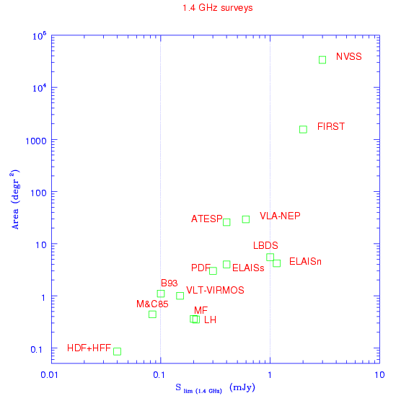
Exploration of the Universe
ASKAP
Uncharted
territory!
Increasing area
Increasing sensitivity

Slide 7
ASKAP Overview
ASKAP Science Goals
ASKAP Scope
ASKAP Location – the Murchison Radio-astronomy Observatory
Progress
  Antennas
  Phased Array Feeds (PAFs)
  Digital Systems
  Network connection to Pawsey HPC Centre for SKA Science
  Computing
  MRO Infrastructure and Power
  MRO Support Facility (Geraldton)
ASKAP Design Enhancements – Mark II
Current Status

Slide 8
ASKAP – What is it ?
It consists of :
- 36 separate 12 metre diameter antennas
- each with a completely new “radio camera” (Phased Array
Feed) to provide wide-field imaging
- massive fibre optic based data transmission system
- custom design “supercomputer” for early data reduction
- SKA compliant fibre connection to Geraldton and onwards
- computer pipeline software for data reduction => imaging
- infrastructure, including roads, buildings, power

Slide 9
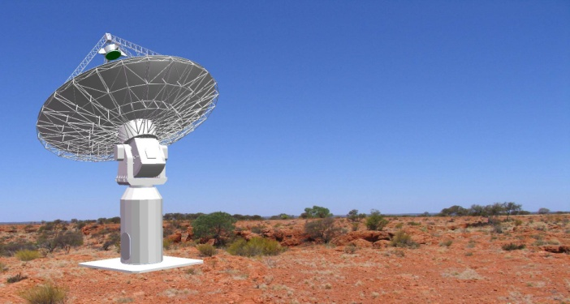



ASKAP Design Specification
A sensitive wide field-of-view telescope
Number of dishes 36
Dish diameter 12 m
Max baseline 6km
Resolution 10” (6km array), 30” (2km core)
Sensitivity 70 m²/K
Field of View 30 deg²
Speed 1.5x10⁵ m⁴/K^{2.}deg²
Observing frequency 700 – 1800 MHz
Processed Bandwidth 300 MHz
Channels 16k
Focal Plane Phased Array 188 elements (94 dual pol)
Dish area = 4072m²
630 Pairs of dishes
Notes:
9

Slide 10
ASKAP Design Specification
A sensitive wide field-of-view telescope
Number of dishes 36
Dish diameter 12 m
Max baseline 6km
Resolution 10” (6km array), 30” (2km core)
Sensitivity 70 m²/K
Field of View 30 deg²
Speed 1.5x10⁵ m⁴/K^{2.}deg²
Observing frequency 700 – 1800 MHz
Processed Bandwidth 300 MHz
Channels 16k
Focal Plane Phased Array 188 elements (94 dual pol)
Dish area = 4072m²
630 Pairs of dishes
Notes:
10

Slide 11
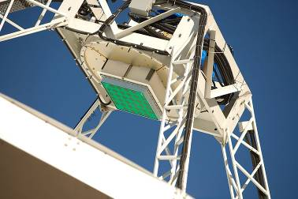
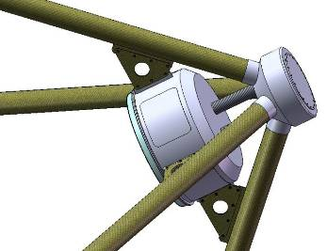
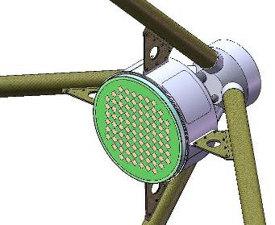
Phased Array Feed
Total bandwidth processed = 2.1THz
~188 elements x 36 antennas x 0.3GHz

Slide 12



Slide 13
ASKAP Overview
ASKAP Science Goals
ASKAP Scope
ASKAP Location – the Murchison Radio-astronomy Observatory
Progress
  Antennas
  Phased Array Feeds (PAFs)
  Digital Systems
  Network connection to Pawsey HPC Centre for SKA Science
  Computing
  MRO Infrastructure and Power
  MRO Support Facility (Geraldton)
ASKAP Design Enhancements – Mark II
Current Status

Slide 14
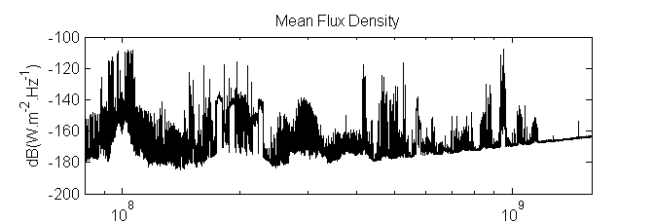
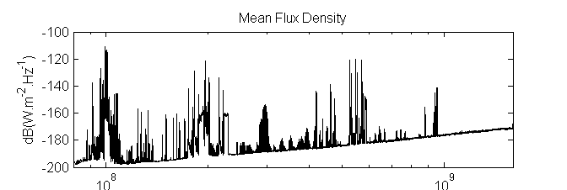
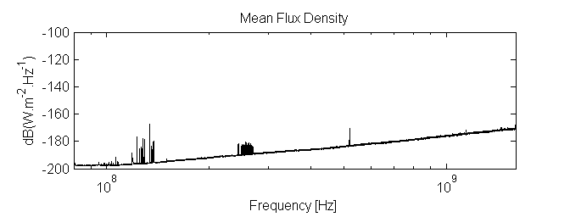
Why remote Western Australia ?
- the RFI environment !
Sydney
Pop. 4 million
RF Environment
Narrabri (ATCA)
Pop. 6,000
Murchison Shire
(Equal area MA)
Pop. 120

Slide 15
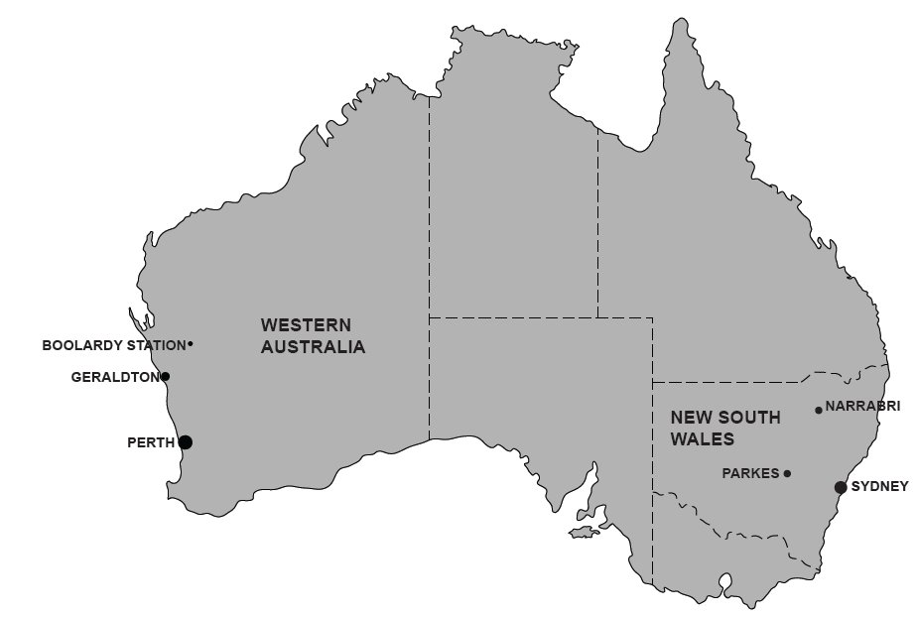
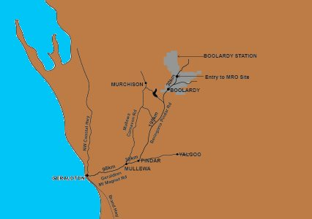
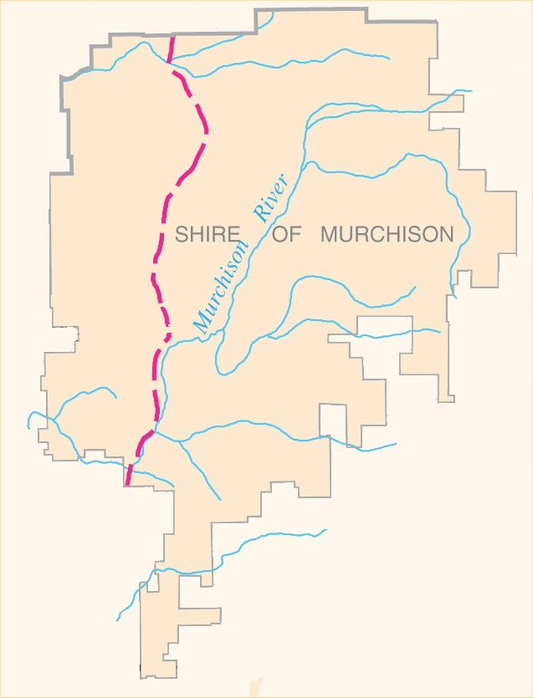
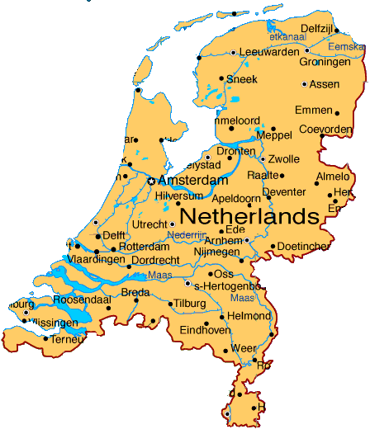

Murchison Radio Observatory
gazetted towns: 0
population: “up to 120”

Slide 16
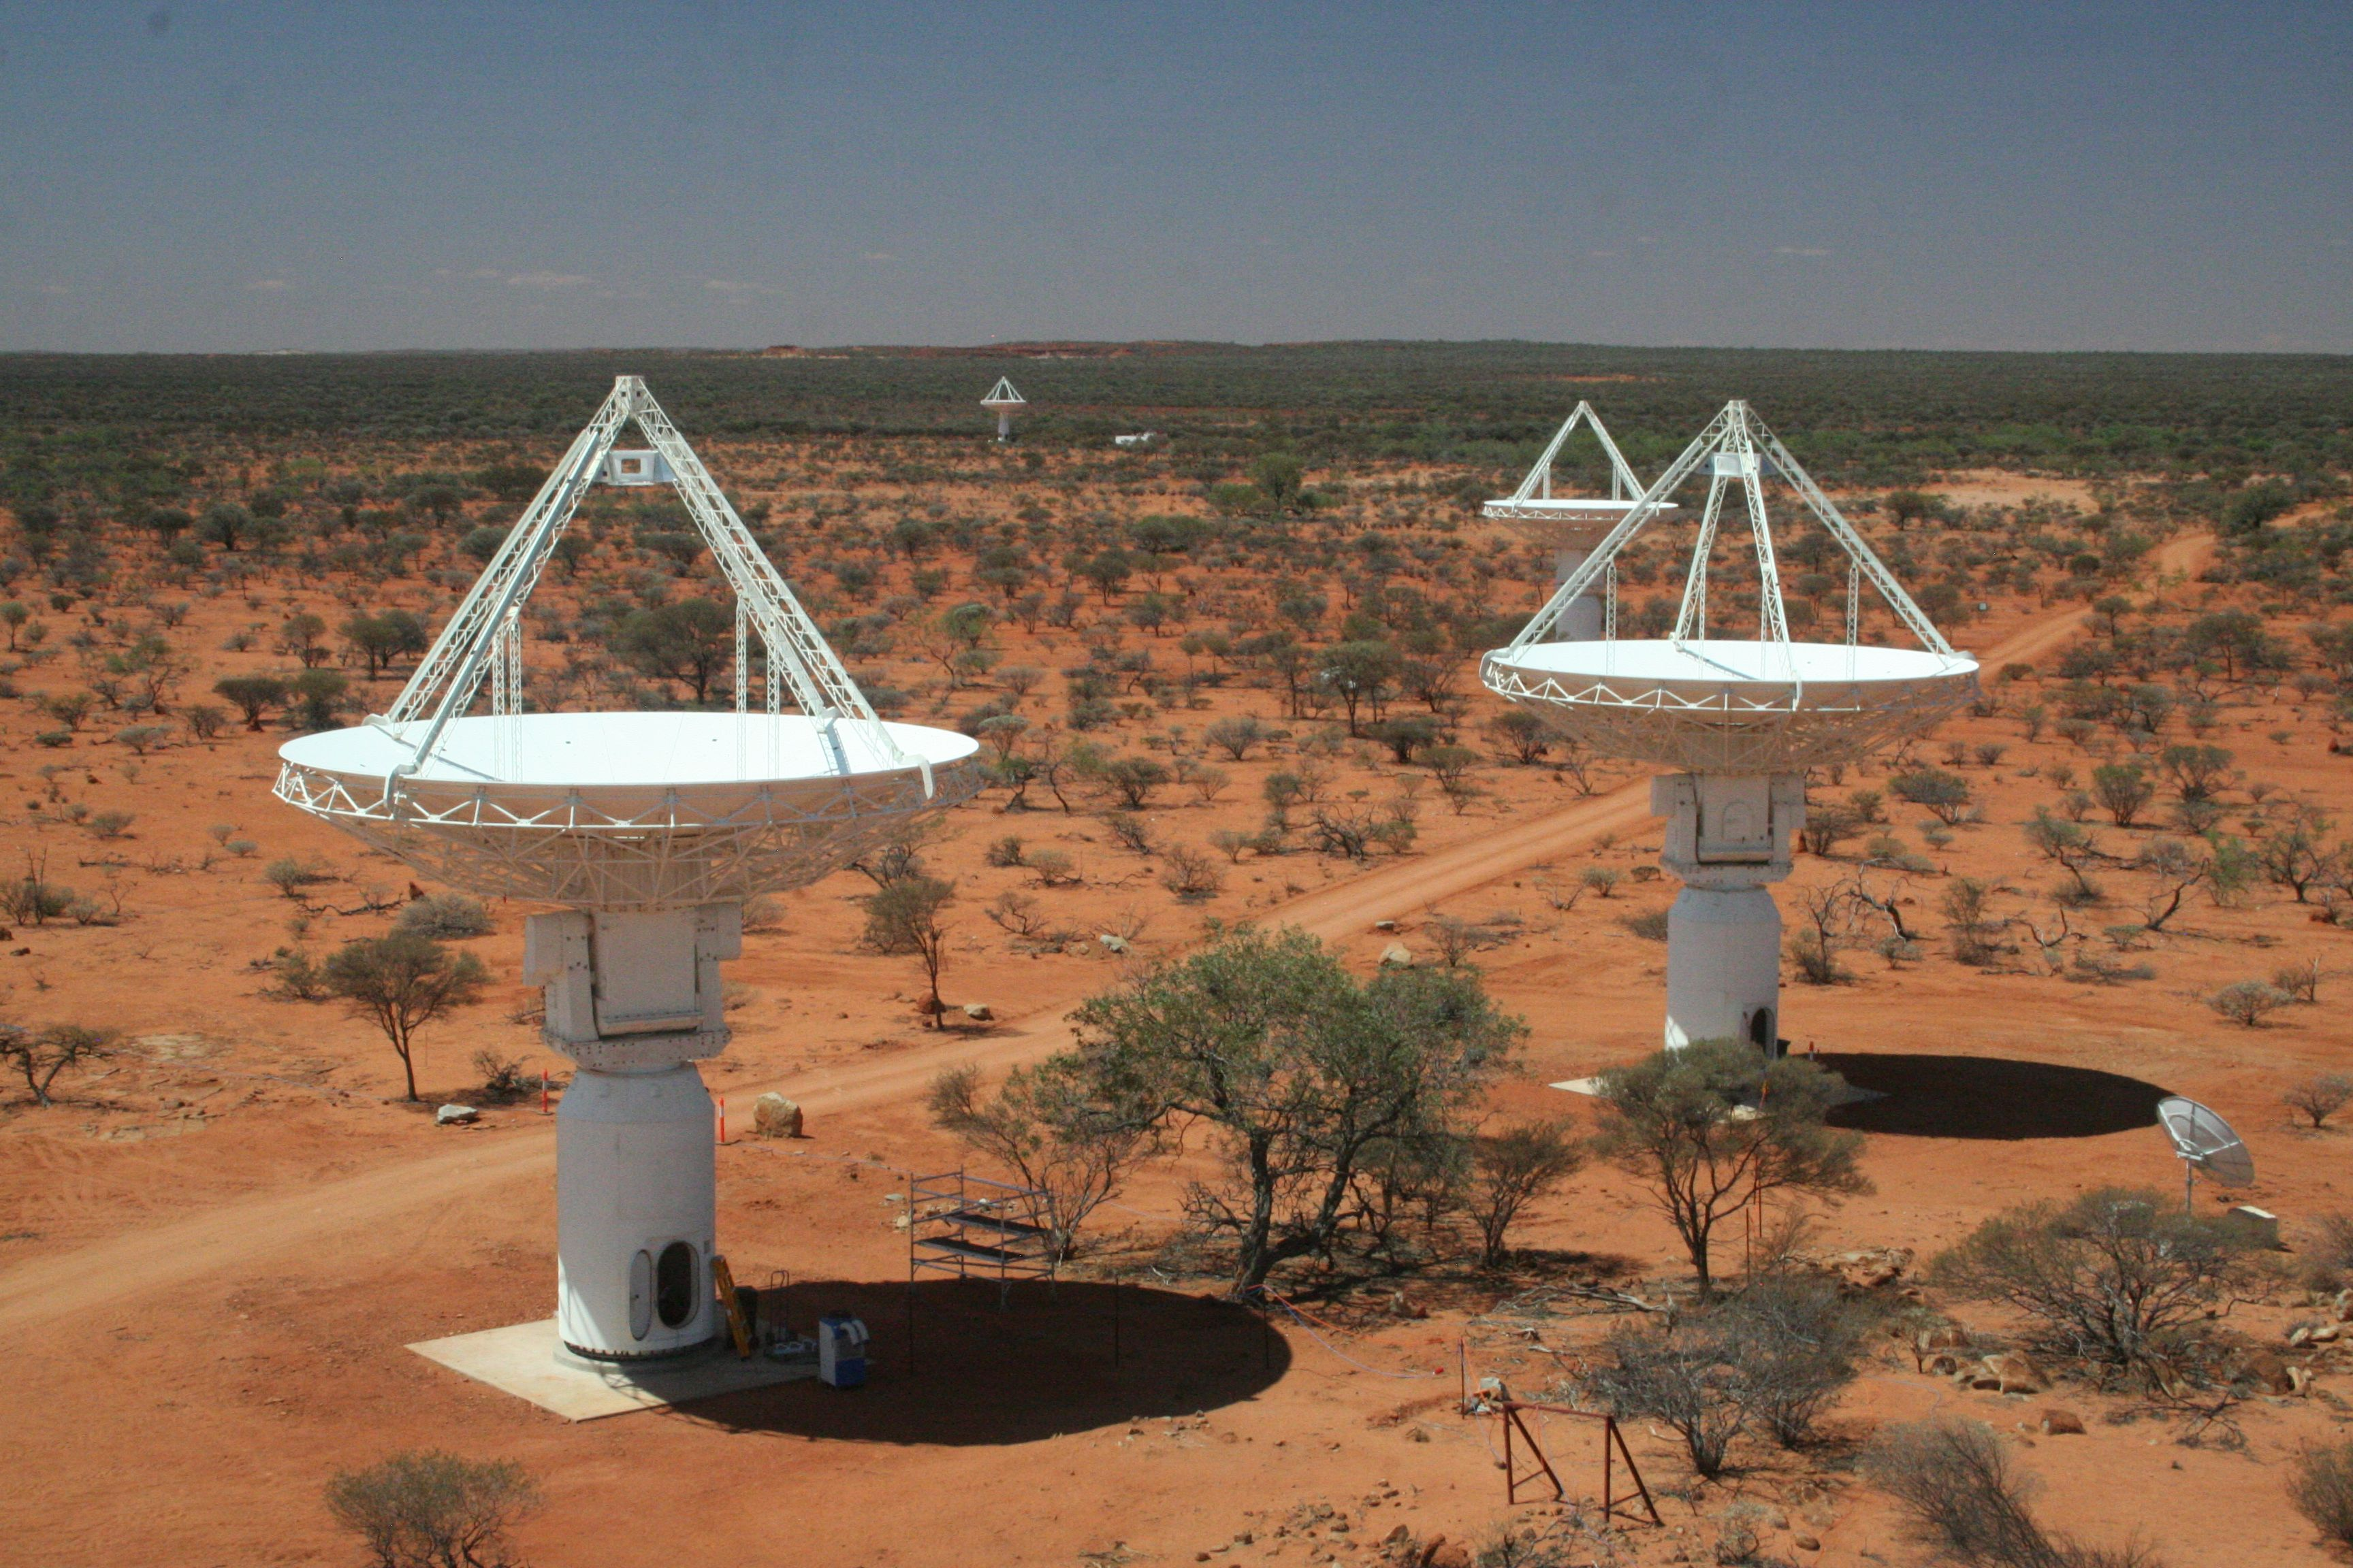
ASKAP Why the Murchison ?

Slide 17
ASKAP Overview
ASKAP Science Goals
ASKAP Scope
ASKAP Location – the Murchison Radio-astronomy Observatory
Progress
  Antennas
  Phased Array Feeds (PAFs)
  Digital Systems
  Network connection to Pawsey HPC Centre for SKA Science
  Computing
  MRO Infrastructure and Power
  MRO Support Facility (Geraldton)
ASKAP Design Enhancements – Mark II
Current Status

Slide 18
ASKAP – Antennas
  Contract with CETC54 (The 54th Research Institute of China Electronics
  Technlogy Group Corp) in China
  For 36, 3-axis, 12 metre diameter antennas suitable for 10 GHz (1.0mm rms)
    consistently achieving 0.55 mm RMS
    around 5 days to assemble
  Twelve CETC54 engineers and technicians on site (plus 6 local staff)
  Total of 22 antennas now on site
    Nine antennas are completed
    Ten more in assembly (three more in parts on site)
    4 arriving every 5 weeks
  Completion of all 36 scheduled Q2 2012

Slide 19

ASKAP Antennas – 27 – 36 in manufacture

Slide 20

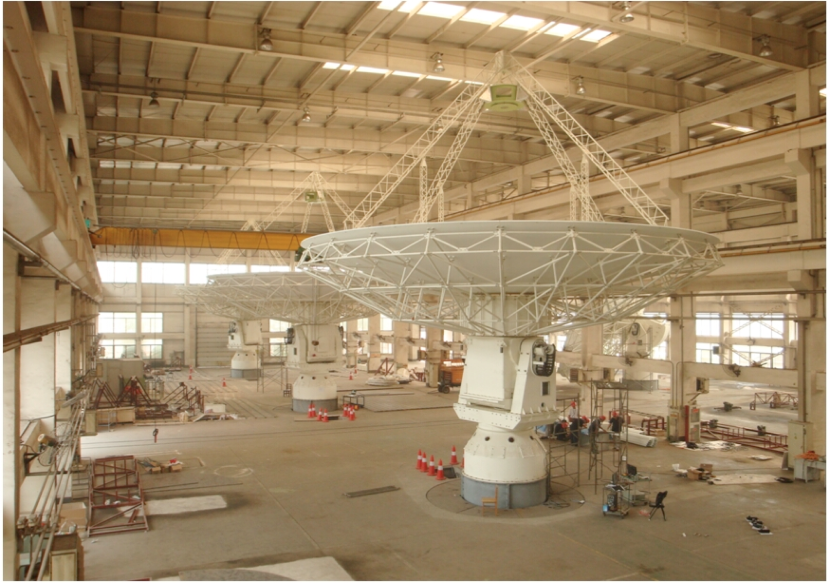
ASKAP Antennas

Slide 21
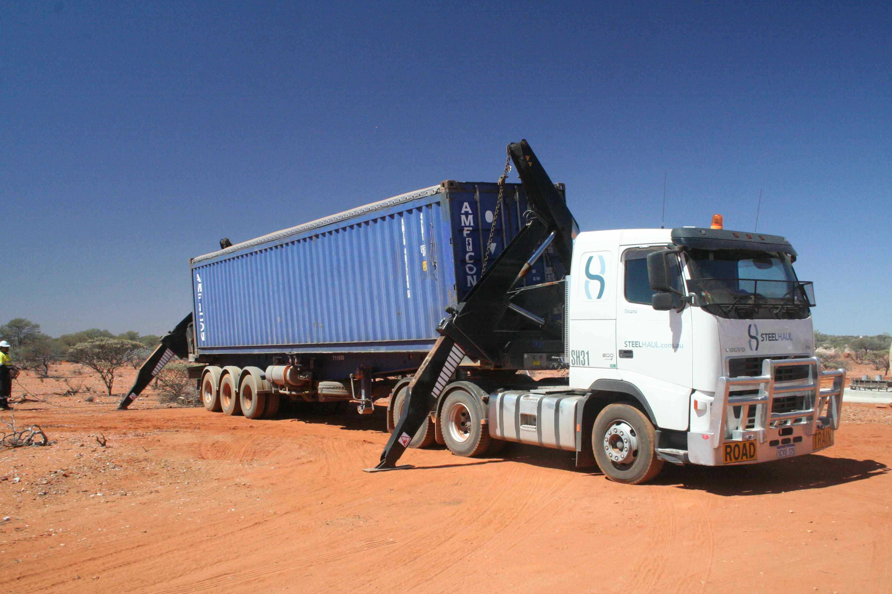
ASKAP Antennas

Slide 22
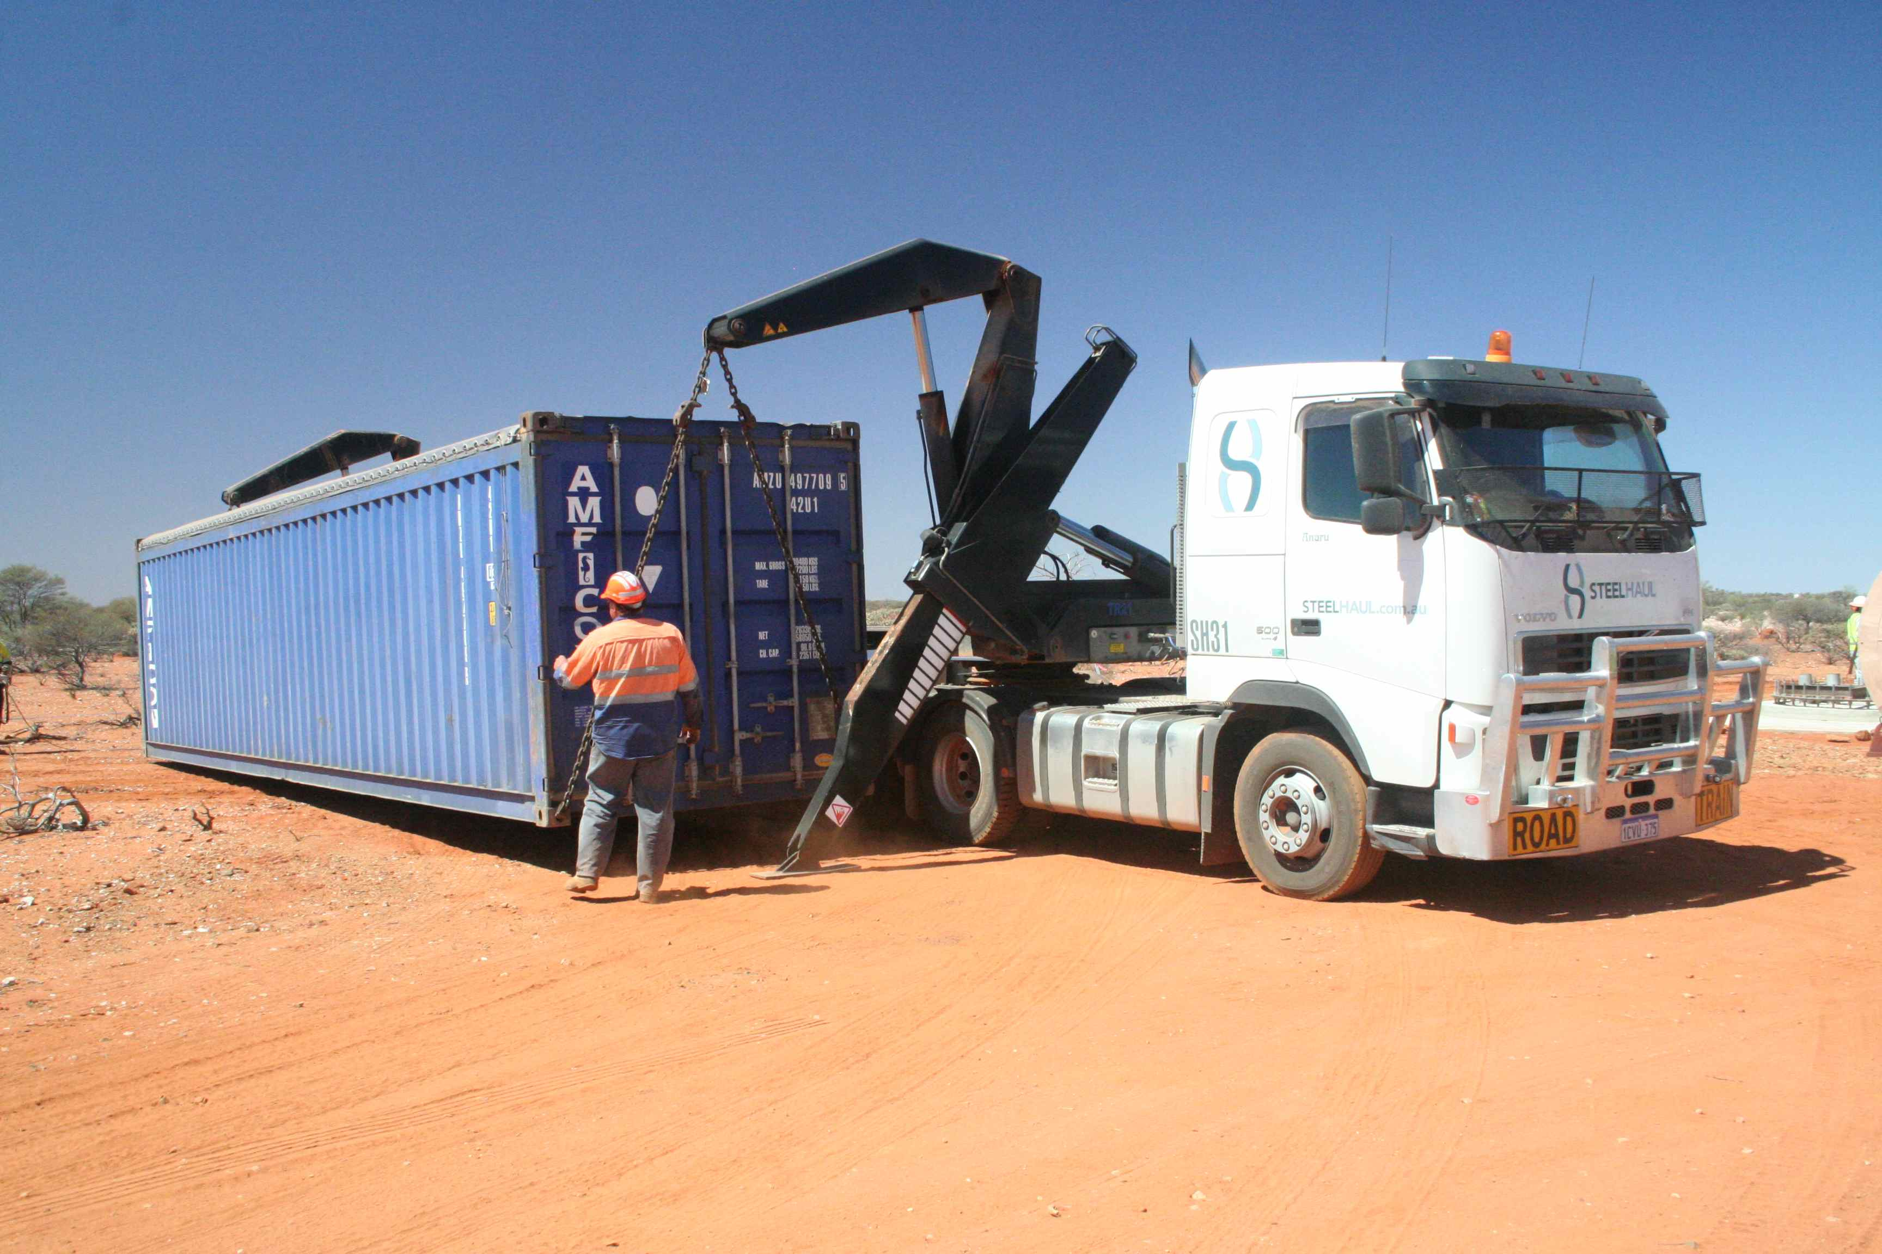
ASKAP Antennas

Slide 23
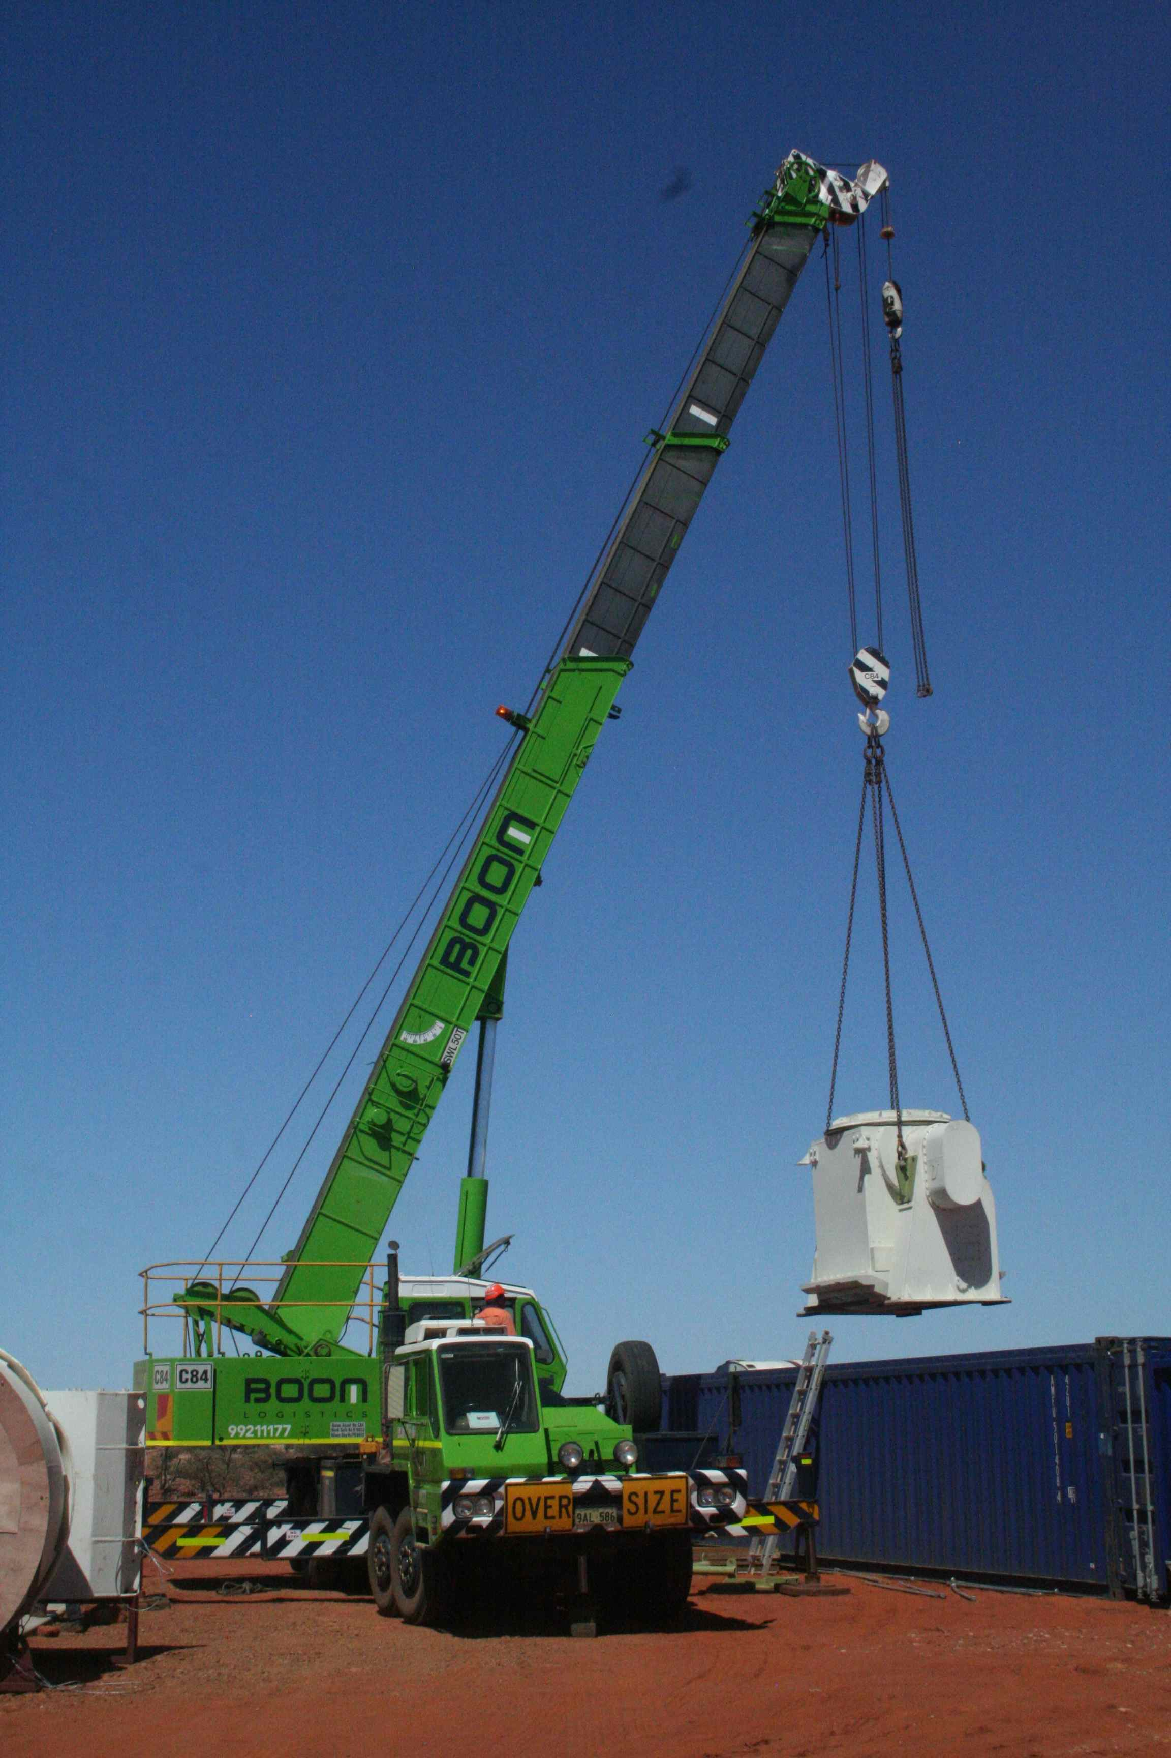
ASKAP Antennas

Slide 24
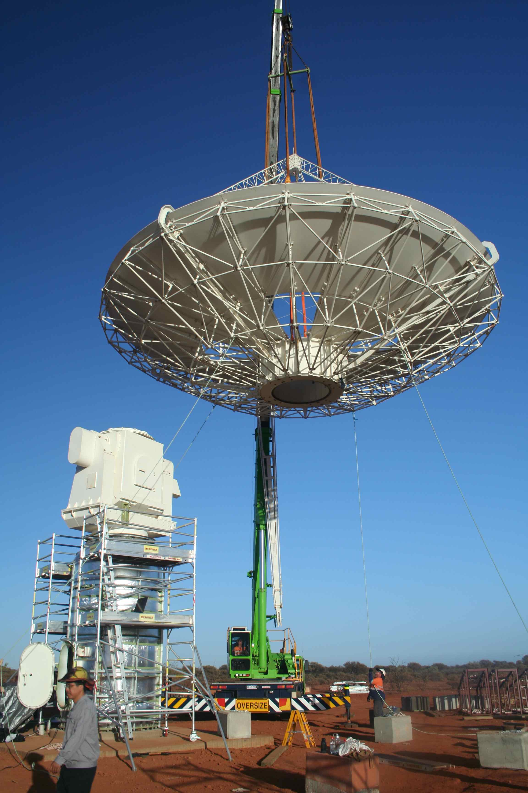
ASKAP Antennas

Slide 25
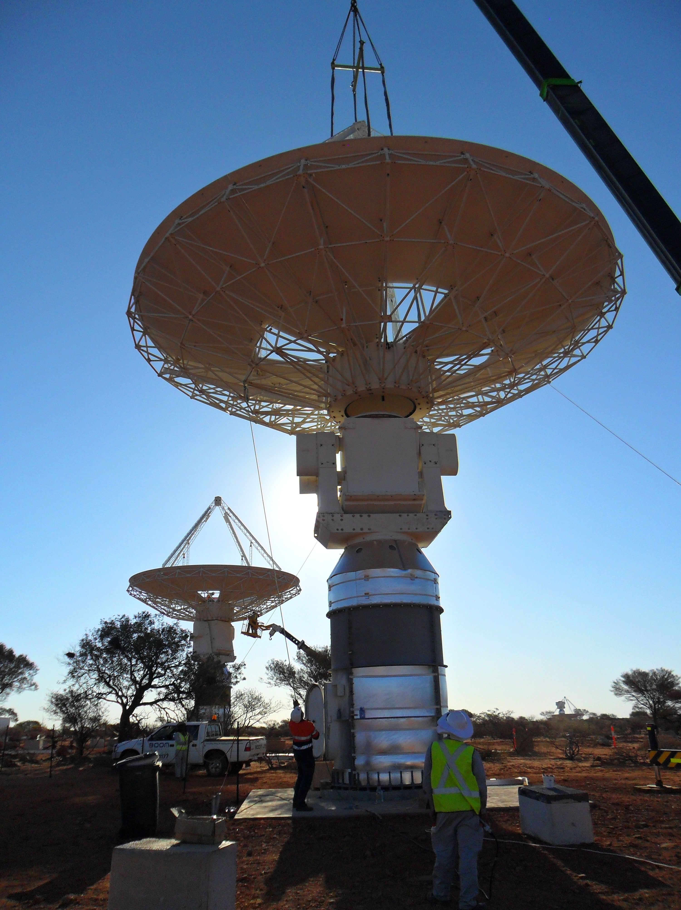
ASKAP Antennas

Slide 26
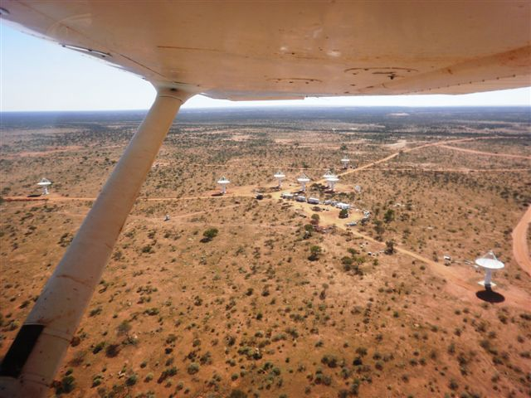

Slide 27
ASKAP Overview
ASKAP Science Goals
ASKAP Scope
ASKAP Location – the Murchison Radio-astronomy Observatory
Progress
  Antennas
  Phased Array Feeds (PAFs)
  Digital Systems
  Network connection to Pawsey HPC Centre for SKA Science
  Computing
  MRO Infrastructure and Power
  MRO Support Facility (Geraldton)
ASKAP Design Enhancements – Mark II
Current Status

Slide 28
ASKAP – Phased Array Feed Receiver
  First full sized ASKAP PAF shipped to MRO 10 October 2011
    installed on ASKAP antenna 23 October 2011
  Two more shipped November, installed early December
    an error in machining a plate meant water leaked in from heavy rains
    these two PAFs have been removed and returned to Marsfield for
    cleaning and checks
    two new PAFs will be sent to the MRO 24th March
  Remaining three will be installed by mid-year for BETA test bed
  Mark II Variant in design – delivery scheduled for 6 in March 2013

Slide 29
ASKAP PAF Aperture Beamformed Receiver Temp (Boresight Beam)
Sensitivity matching conditions: Hay, IJMOT 5,6,2010 & ICEAA 2010.
Measurement: unpublished

Slide 30
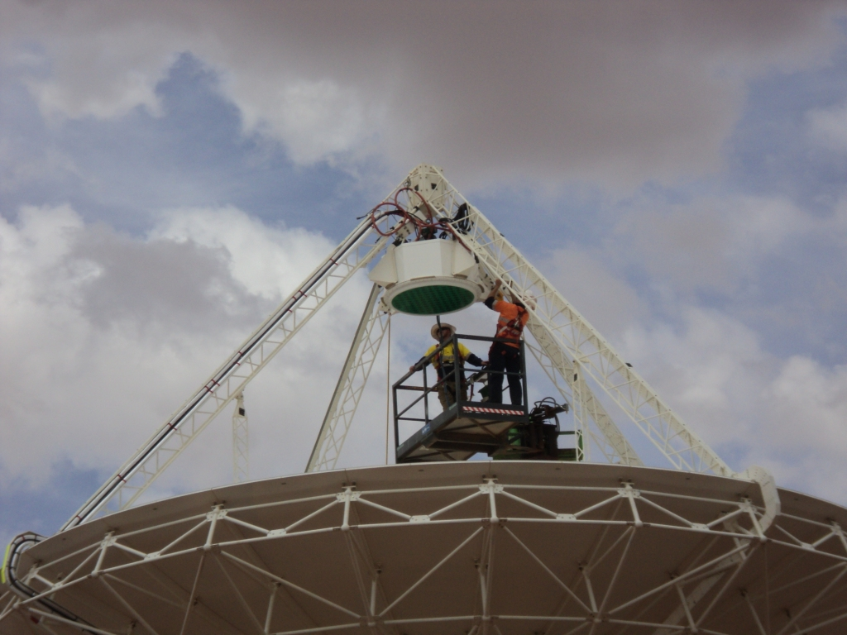

Slide 31
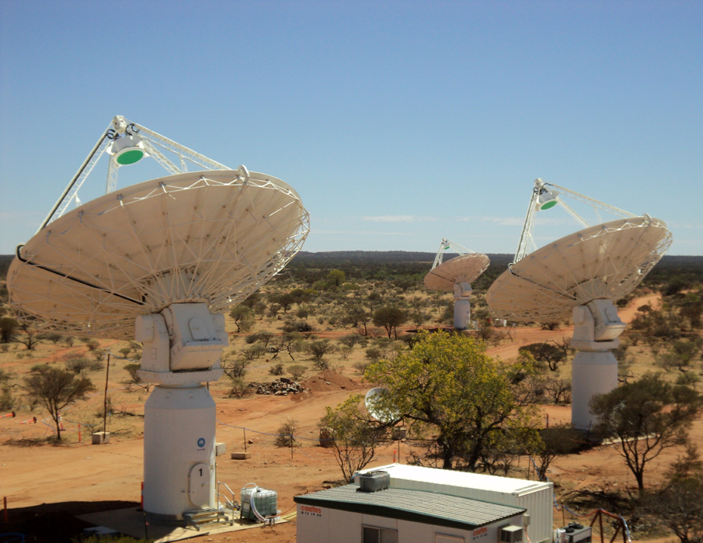

Slide 32
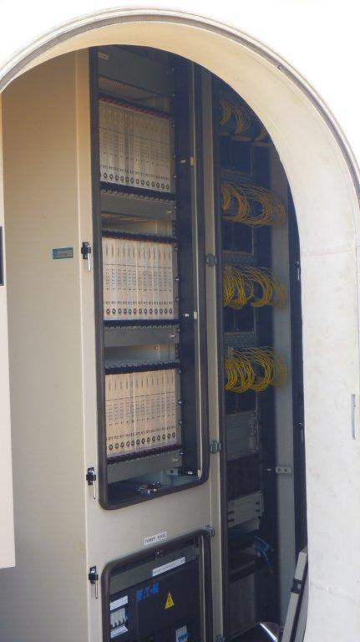
Analog racks, power supplies,
Digitiser and transport
(shielded racks) in pedestal 3
23 October 2011

Slide 33
ASKAP Overview
ASKAP Science Goals
ASKAP Scope
ASKAP Location – the Murchison Radio-astronomy Observatory
Progress
  Antennas
  Phased Array Feeds (PAFs)
  Digital Systems
  Network connection to Pawsey HPC Centre for SKA Science
  Computing
  MRO Infrastructure and Power
  MRO Support Facility (Geraldton)
ASKAP Design Enhancements – Mark II
Current Status

Slide 34
ASKAP – Digital Systems II
Why build our own custom processing system:
  Massive data rates – 72 Terabits per second raw
    144 500 GB disks per second or 1,440 Blue-Ray disks per second
    = 124 MILLION Blue-Ray disks per day
    = stack 62 km tall
    or
    “Post processor” data rate is about 1 DVD per second
    = 31 MILLION DVD’s per year
  Over 1 Peta operations per second needed on this simply for the
  filtering, beamforming and correlation
  800 dedicated processor cards needed for this using a special type
  of programmable computer chip (FPGAs: Virtex 6)
No commercial supercomputer can handle these data rates AND the processing needs

Slide 35
ASKAP – Digital Systems
Beamformer and Correlator use same 16 card ATCA chassis and Redback processor card
Beamformer:
- one per antenna
- 16 cards (64 V6 FPGA) per beamformer chassis
- 1.8 Tbit/sec input data rate per chassis
- 188 x 10 Gb optical fibre input via 12 fibre “ribbon cable”
- 2.4 kW power consumption each chassis
- 36 chassis
Correlator:
- 16 ATCA chassis
- 16 cards
= Total of 800 custom processor boards
= 320 kW of electricity !

Slide 36


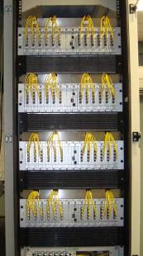
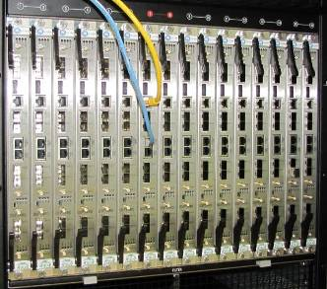
ASKAP – Digital Systems
BEAMFORMER

Slide 37
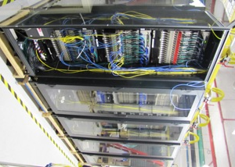
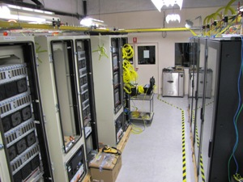
ASKAP – Digital Systems
Integration and test area (Digital)

Slide 38
ASKAP Overview
ASKAP Science Goals
ASKAP Scope
ASKAP Location – the Murchison Radio-astronomy Observatory
Progress
  Antennas
  Phased Array Feeds (PAFs)
  Digital Systems
  Network connection to Pawsey HPC Centre for SKA Science
  Computing
  MRO Infrastructure and Power
  MRO Support Facility (Geraldton)
ASKAP Design Enhancements – Mark II
Current Status

Slide 39
ASKAP – Fibre MRO to Geraldton to Perth
CCTS completed the fibre installation in early June 2011
Three repeater huts fitted with equipment by CSIRO staff (mid June 2011)
  two huts solar powered, one hut grid connected
  economical, low power
First end-to-end (MRO to Geraldton) light on Sunday 19 June 2011
First 1 Gb/sec transmission in mid-July 2011, allowing the eVLBI observation
NBN link Geraldton to Perth completed and tested
Expect full access MRO – Pawsey HPC for SKA Science at 10 Gb/s in
mid February 2012
- 40 Gb/sec May 2012
(Currently ADSL level from Geraldton to outside world)

Slide 40
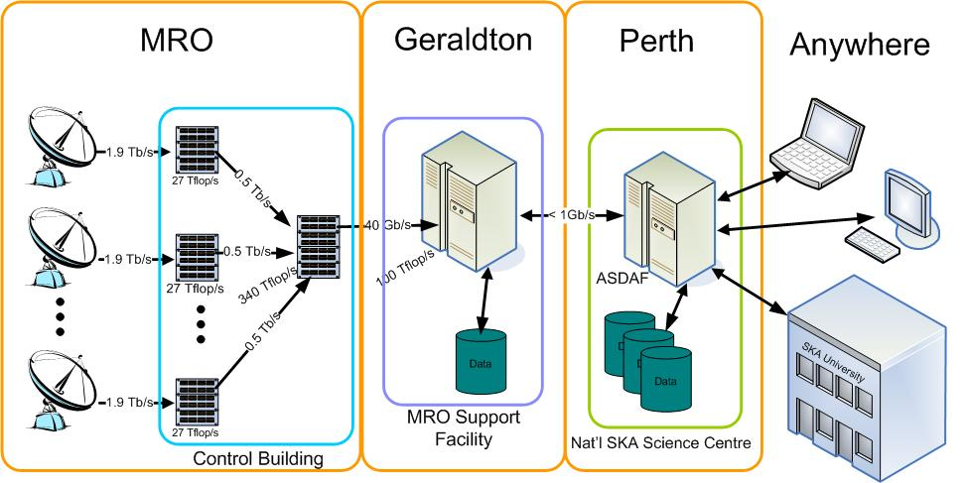
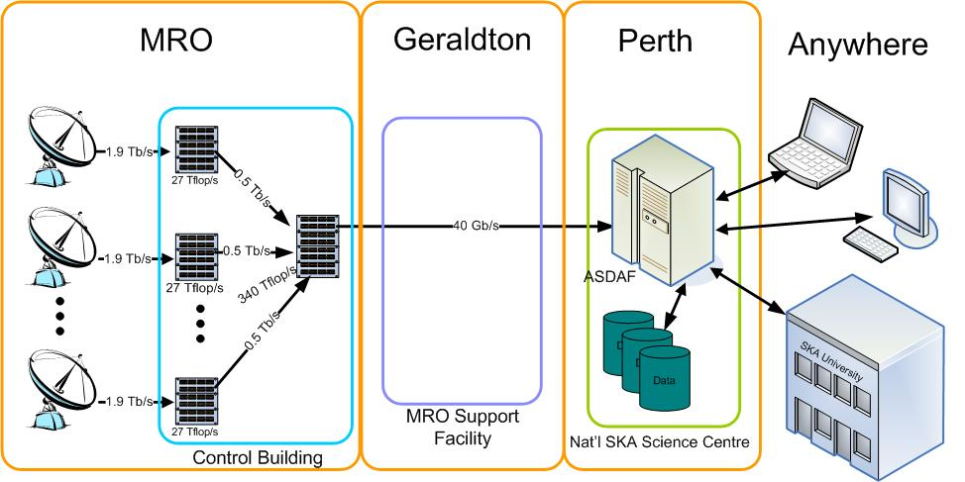
ASKAP System and Data Flow
NBN

Slide 41
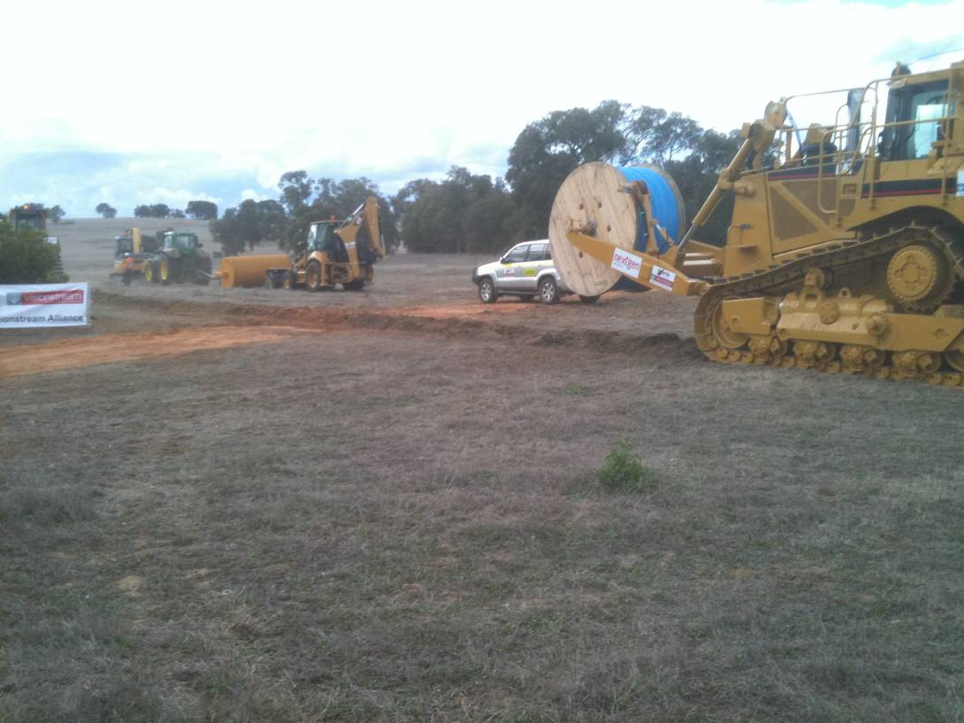
ASKAP System and Data Flow
NBN
21 May 2010

Slide 42

ASKAP Fibre link: MRO to Geraldton

Slide 43
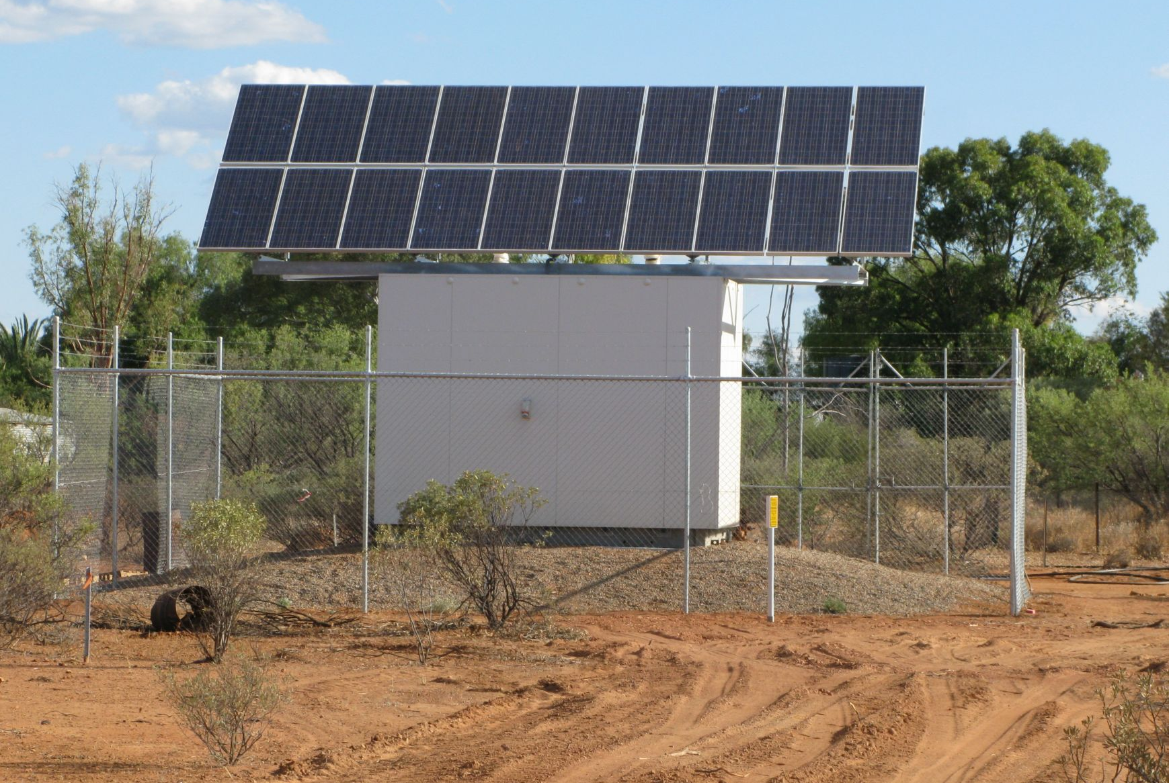
ASKAP – fibre repeater hut

Slide 44
ASKAP Overview
ASKAP Science Goals
ASKAP Scope
ASKAP Location – the Murchison Radio-astronomy Observatory
Progress
  Antennas
  Phased Array Feeds (PAFs)
  Digital Systems
  Network connection to Pawsey HPC Centre for SKA Science
  Computing
  MRO Infrastructure and Power
  MRO Support Facility (Geraldton)
ASKAP Design Enhancements – Mark II
Current Status

Slide 45
ASKAP – Computing
Data rate is still enormous:
- wideband spectral imager/survey instrument –
- 188 individual raw beams (~ 30 “processed”)
- 16,000 spectral channels
- 36 antennas
72 Tbits raw data rate into the Beamformers
Approximately 40 Gb/sec data post-correlation to the imaging computer (Perth,
  520 miles away)
Result: A Petaflop scale machine for imaging required
Initially a 100 Tflop computer needed for sub-section of array (BETA) at Murdoch
  University (Perth) – 87th most powerful supercomputer in the world
$80 million granted to iVEC by Federal Government in 2009 to create the
Pawsey High Performance Computing Centre for SKA Science (Perth)

Slide 46
ASKAP – Pawsey Centre
  Building foundation work started
  Tenders for the supercomputer under evaluation by the review panel now
  Test bore for the geothermal system (120 metres) completed – positive results
    3.3 km deep bore scheduled for completion around October 2012

Slide 47
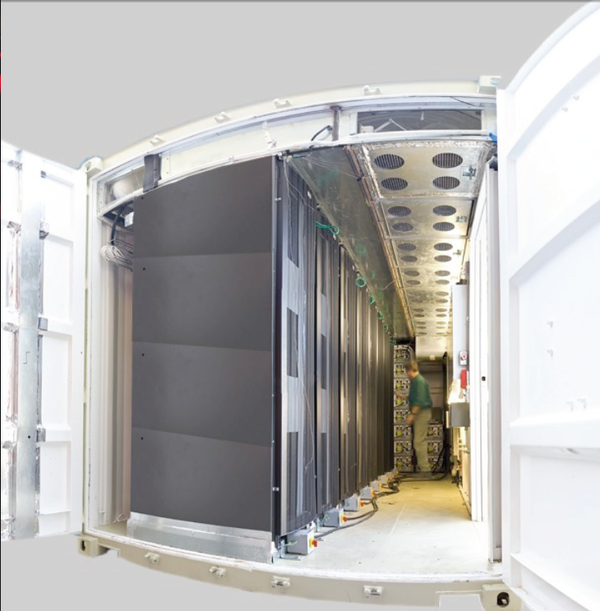

Slide 48
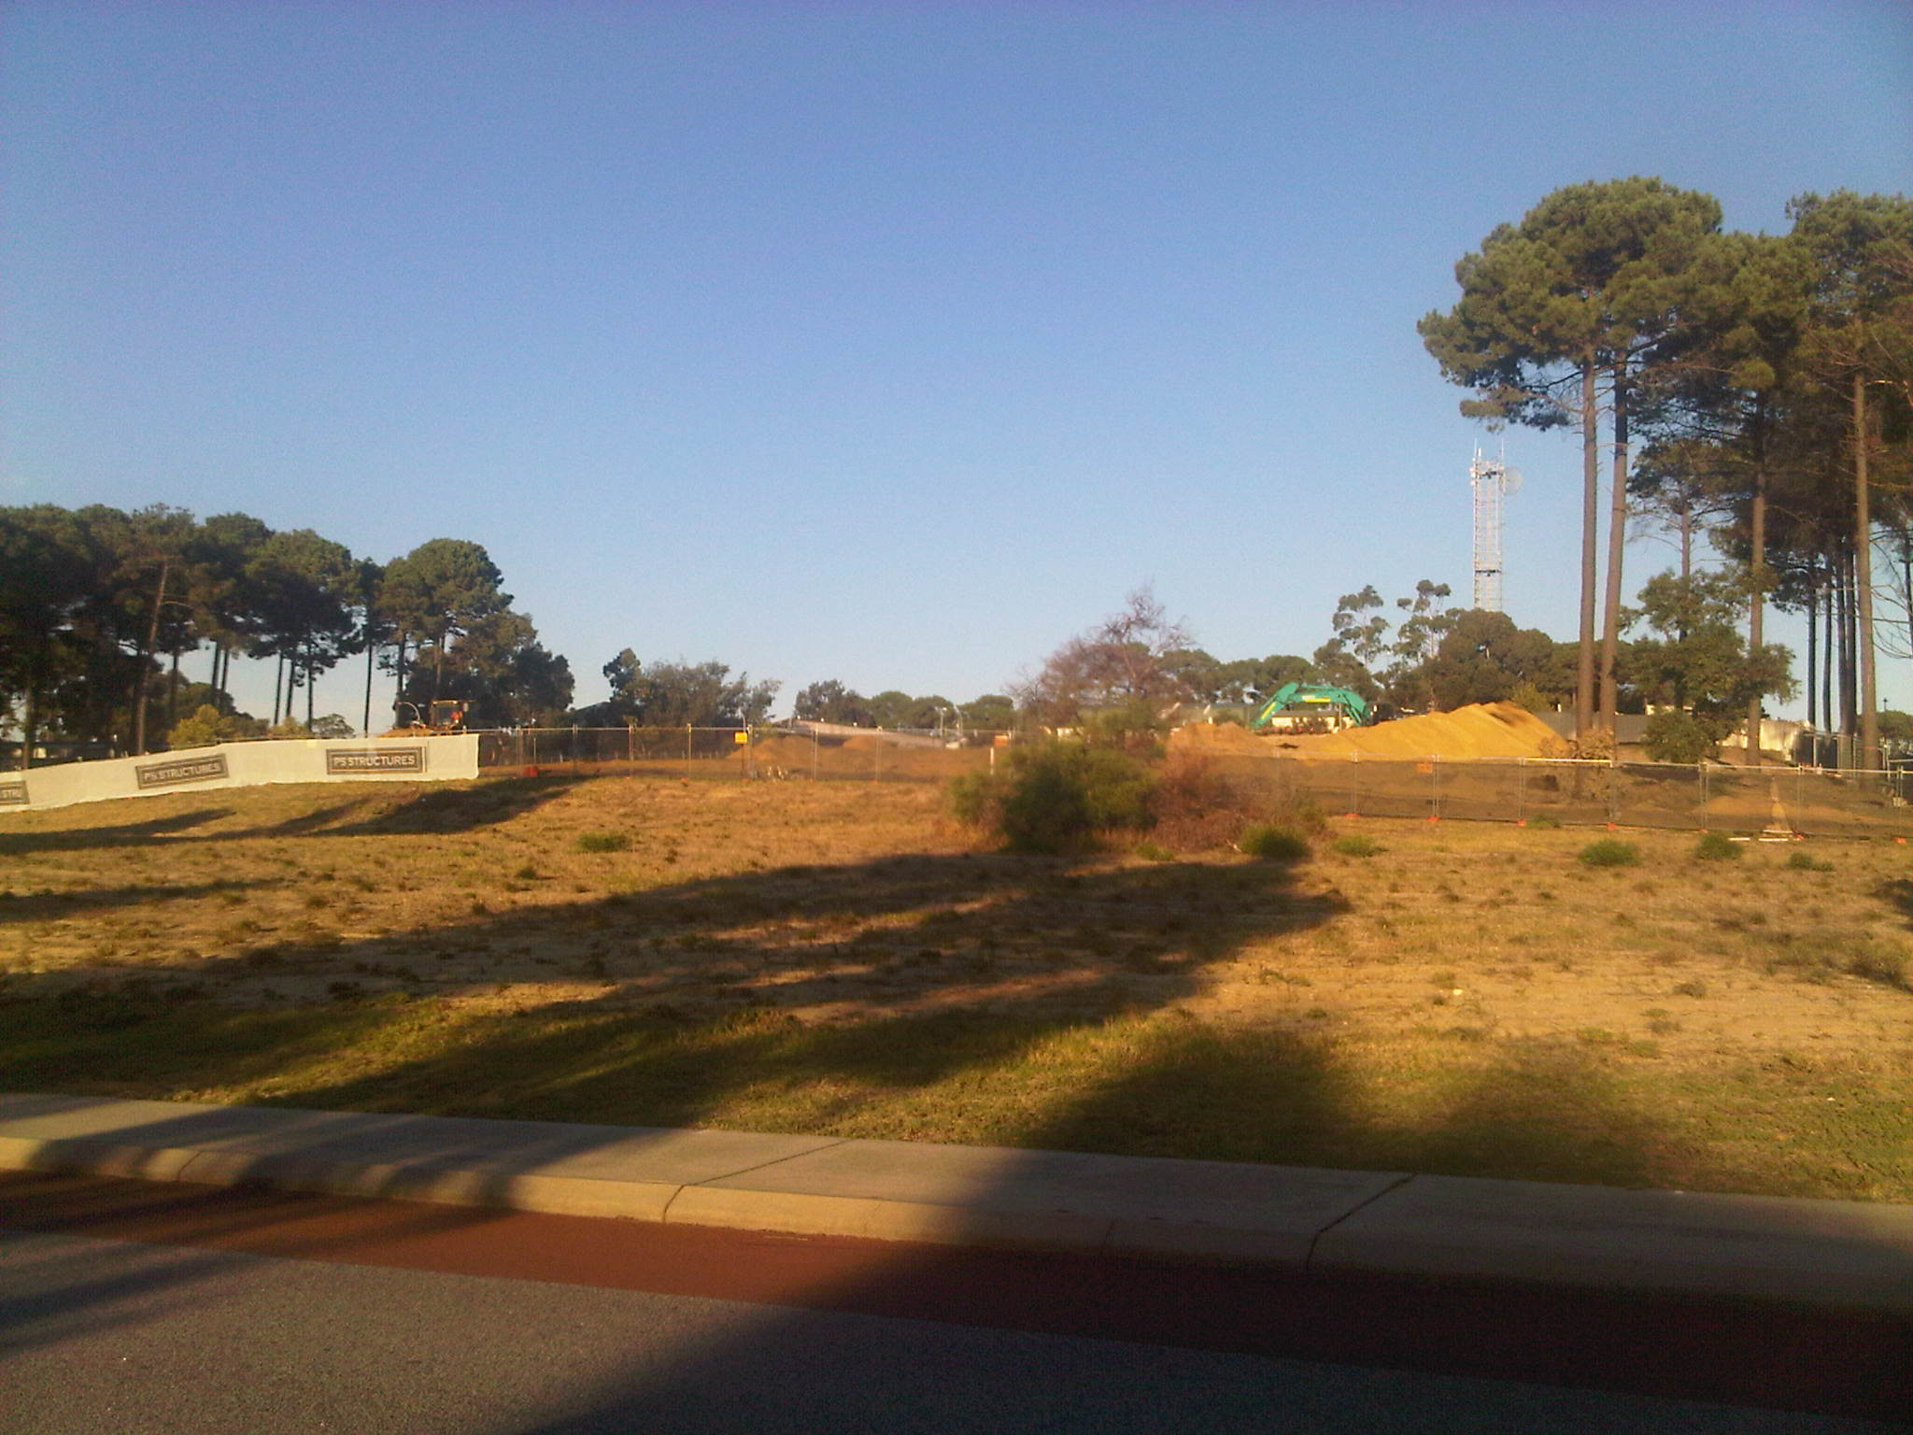

Slide 49
ASKAP Overview
ASKAP Science Goals
ASKAP Scope
ASKAP Location – the Murchison Radio-astronomy Observatory
Progress
  Antennas
  Phased Array Feeds (PAFs)
  Digital Systems
  Network connection to Pawsey HPC Centre for SKA Science
  Computing
  MRO Infrastructure and Power
  MRO Support Facility (Geraldton)
ASKAP Design Enhancements – Mark II
Current Status

Slide 50
ASKAP – MRO Construction
Good progress in 2011:
  roads completed
  fibre and power reticulation around site 98 % completed
  all 36 antenna foundations are completed, transformers installed
  runway refurbishment completed
  Central Building 95% complete
  geothermal cooling system for central building completed
  Commissioning of building systems underway
  12 extra bedrooms and expanded dining installed at Boolardy

Slide 51
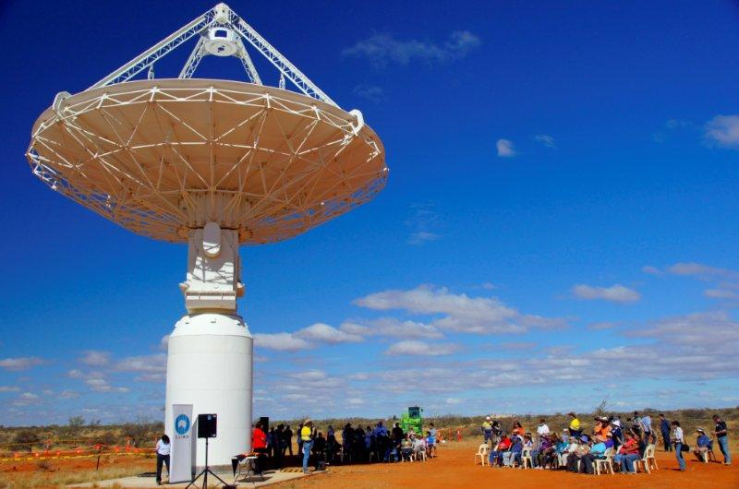
ASKAP – Wajarri Naming Ceremony
Photos: courtesy Steve Douglas

Slide 52
ASKAP – Wajarri Naming Ceremony
Wilara - wi-la-ra (Moon)
Bundarra - bun-da-ra (Stars)
Biyarli - bi-yar-li (Galah)
Jirdilungu - jir-di-lu-ngu (Milky Way)
Balayi - ba - la –yi (Lookout)
Diggiedumble - dig gee dum bull (Table top hill)

Slide 53

ASKAP – Wajarri Naming Ceremony

Slide 54
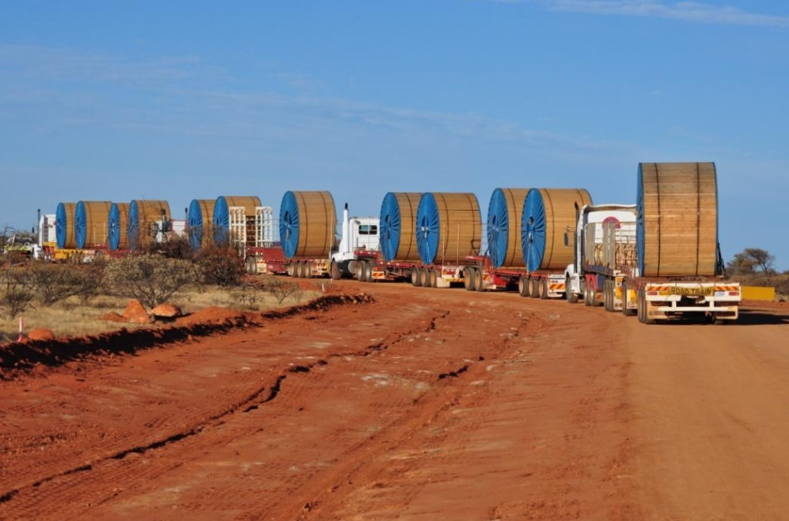

Slide 55
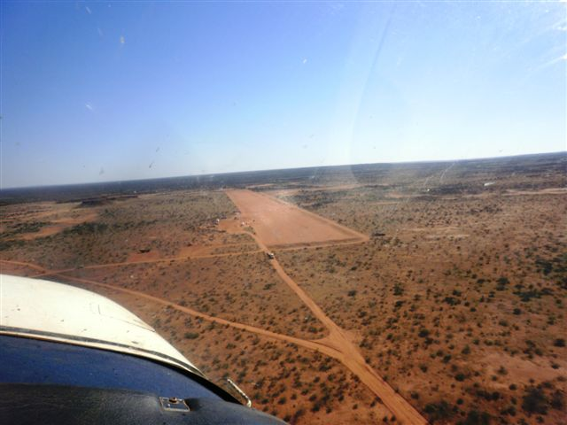

Slide 56
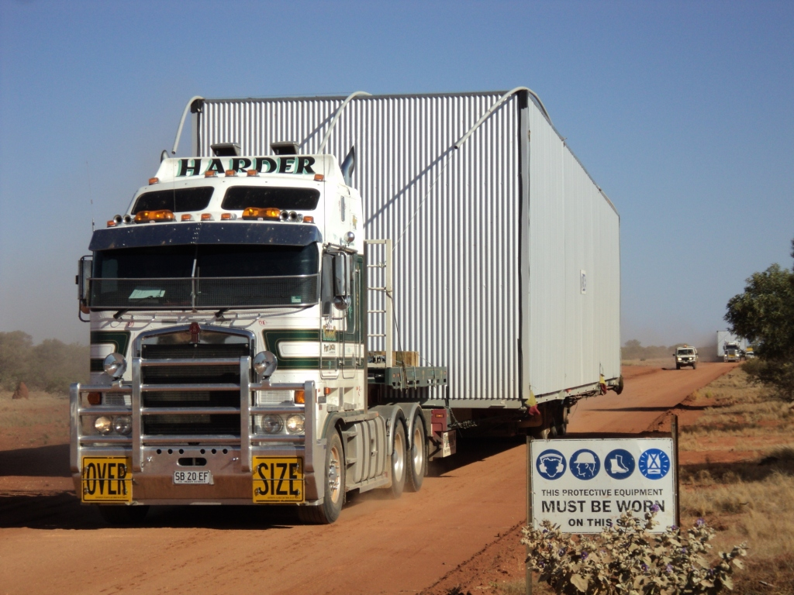
ASKAP – Control Building modules arrive at MRO

Slide 57
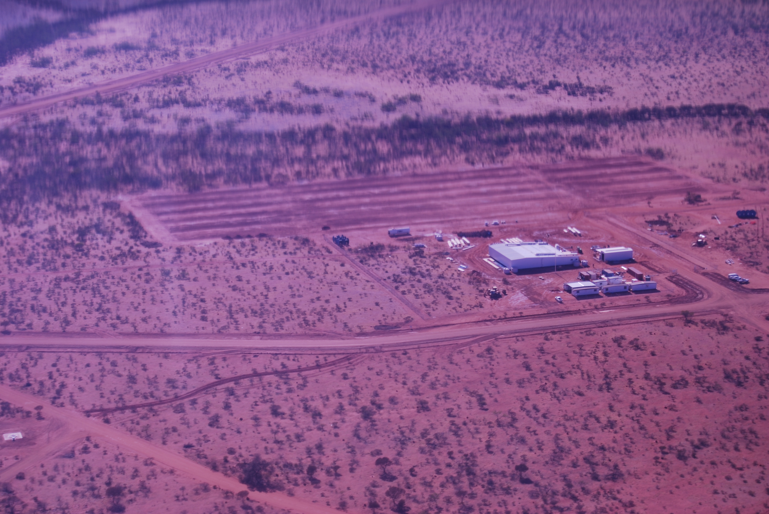
ASKAP – Central Site Building, geothermal cooling

Slide 58
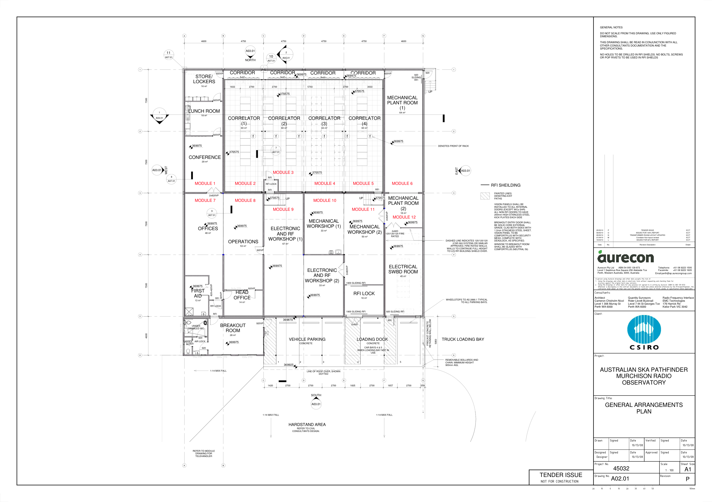
MRO – Control Building

Slide 59
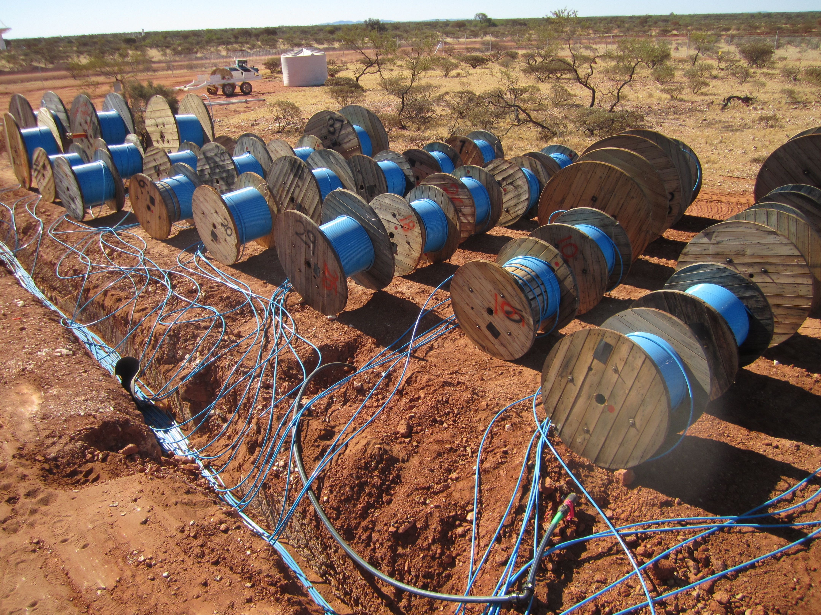
ASKAP – 7,776 ASKAP and 432 MWA fibres

Slide 60
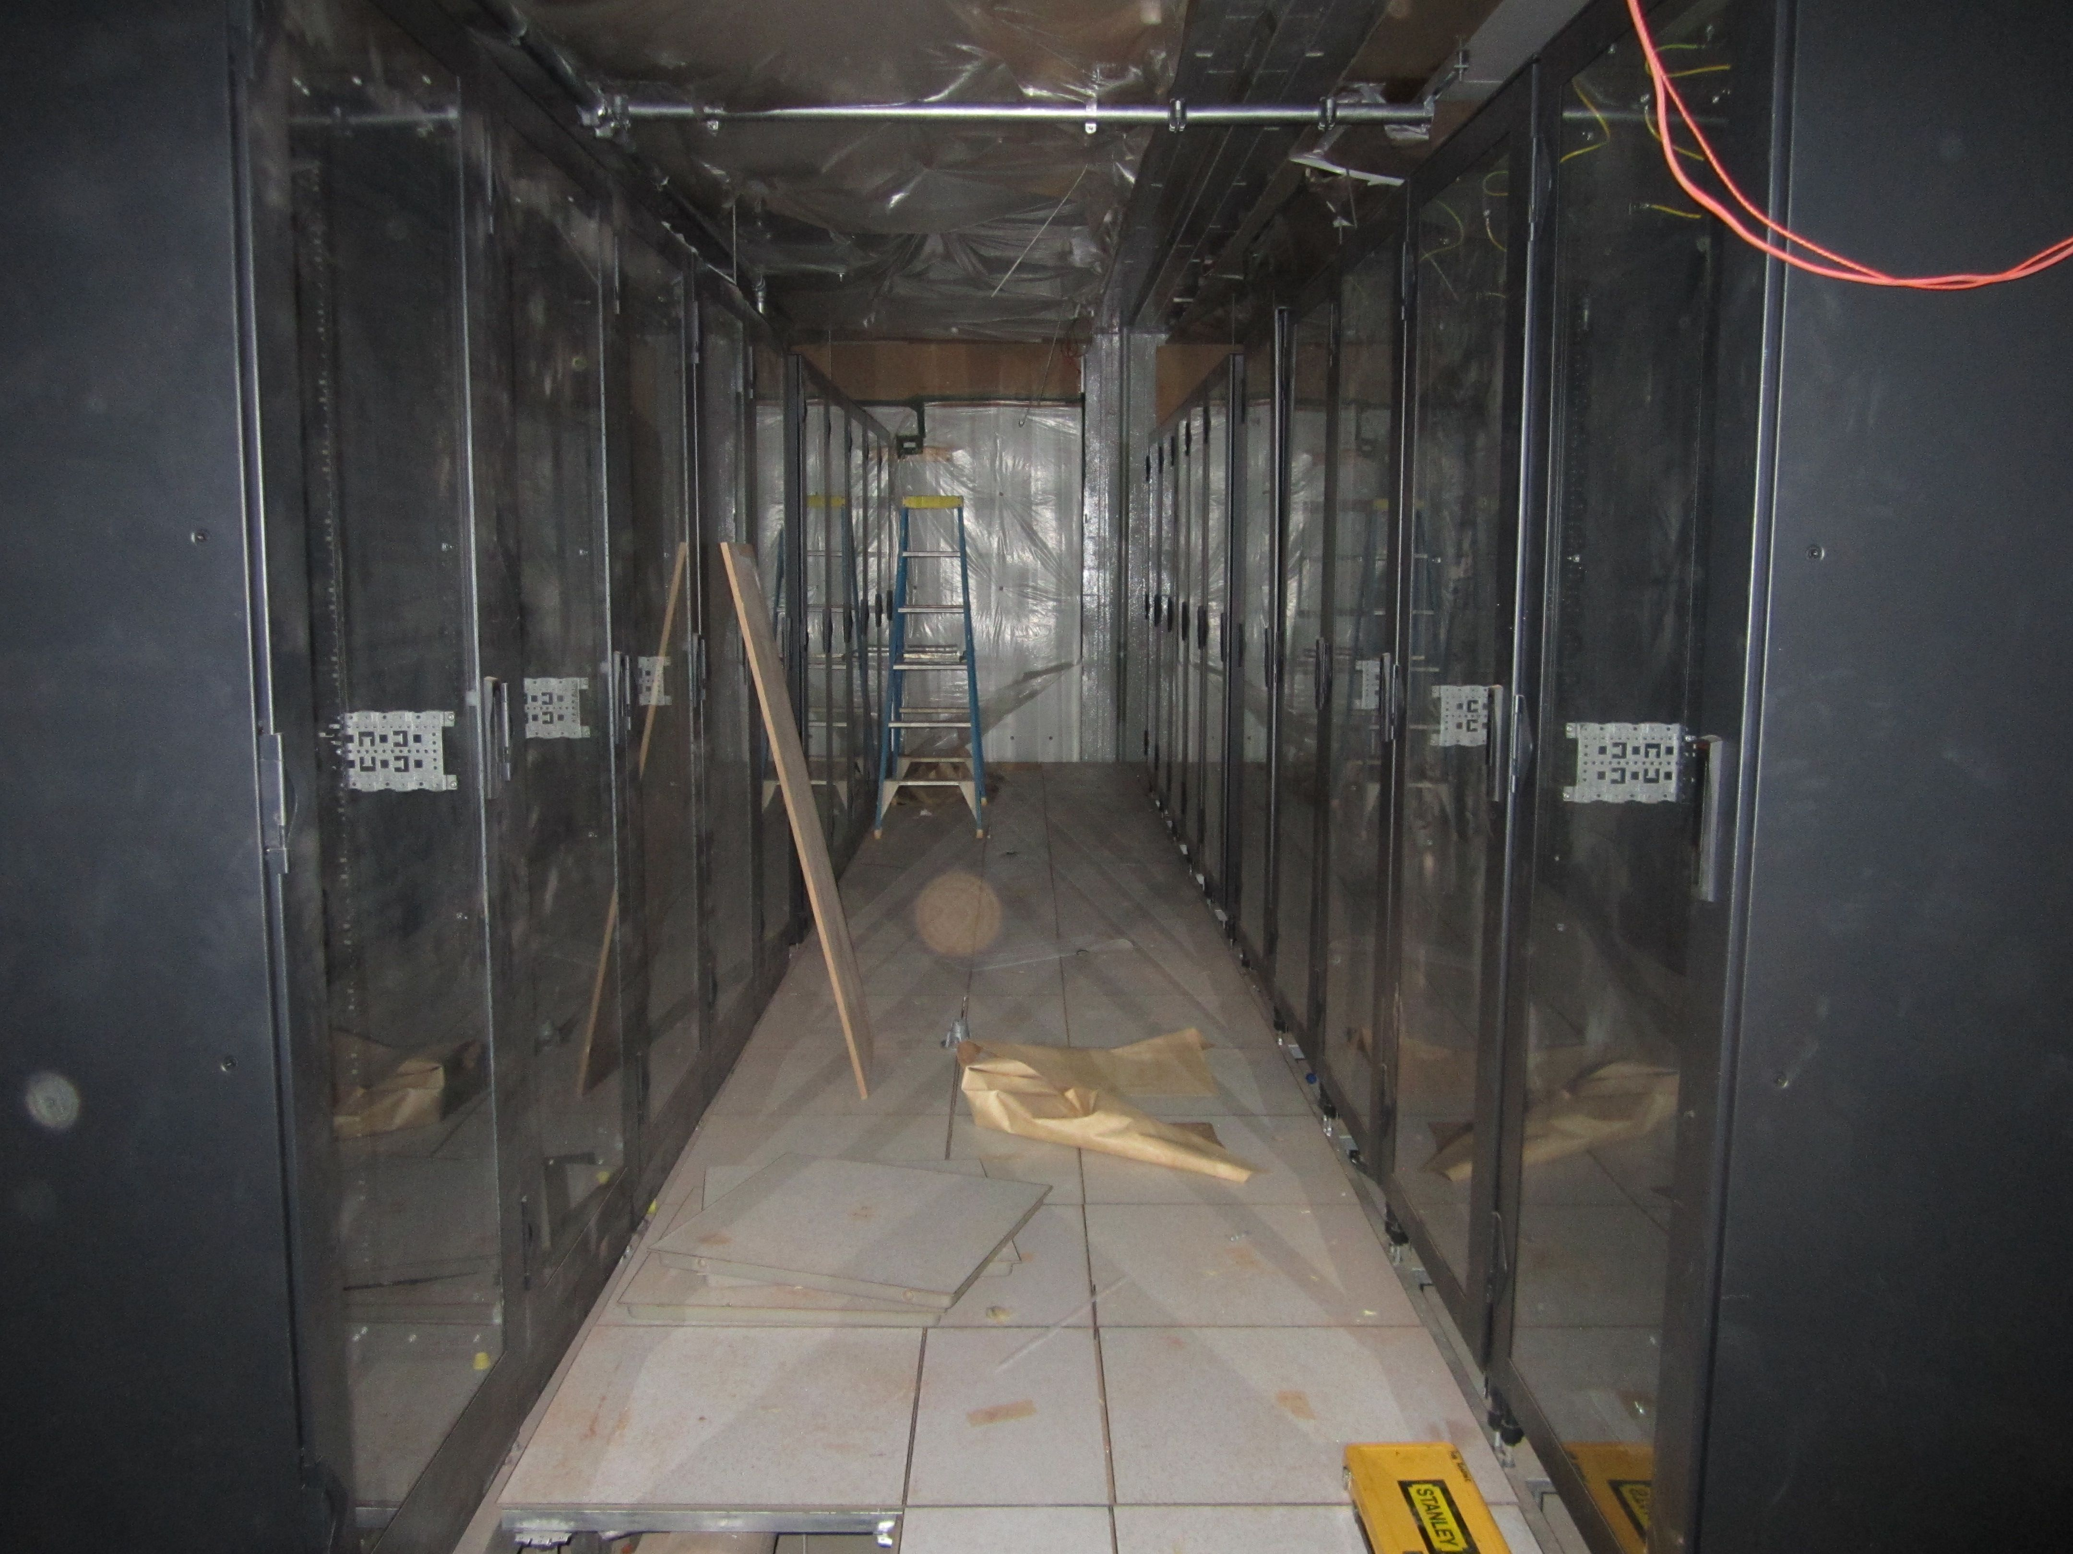
ASKAP – Correlator Room

Slide 61
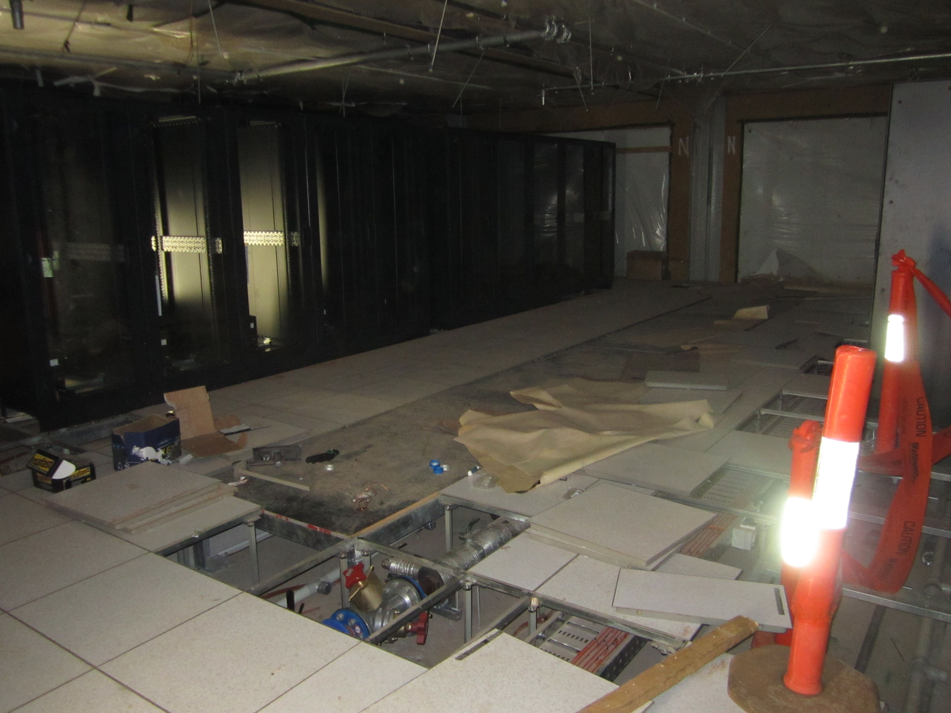
ASKAP – Correlator Room

Slide 62
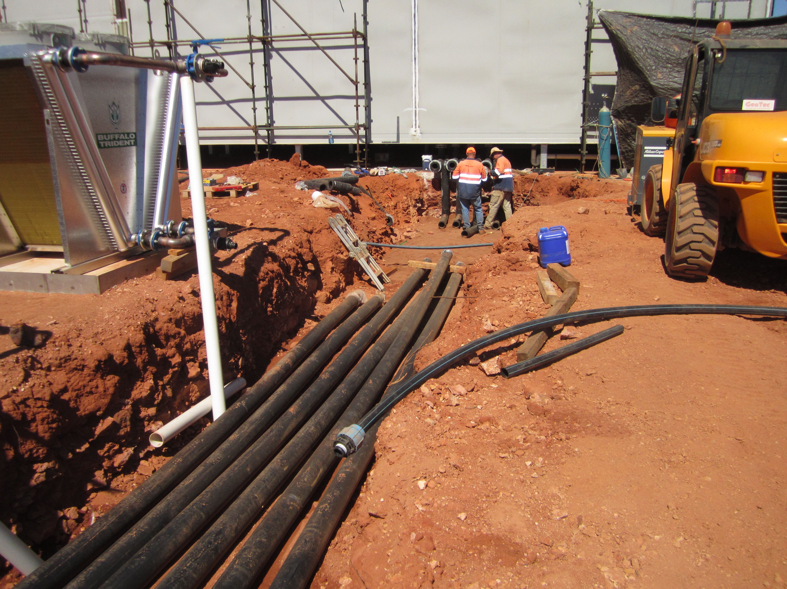
ASKAP – Geothermal cooling

Slide 63
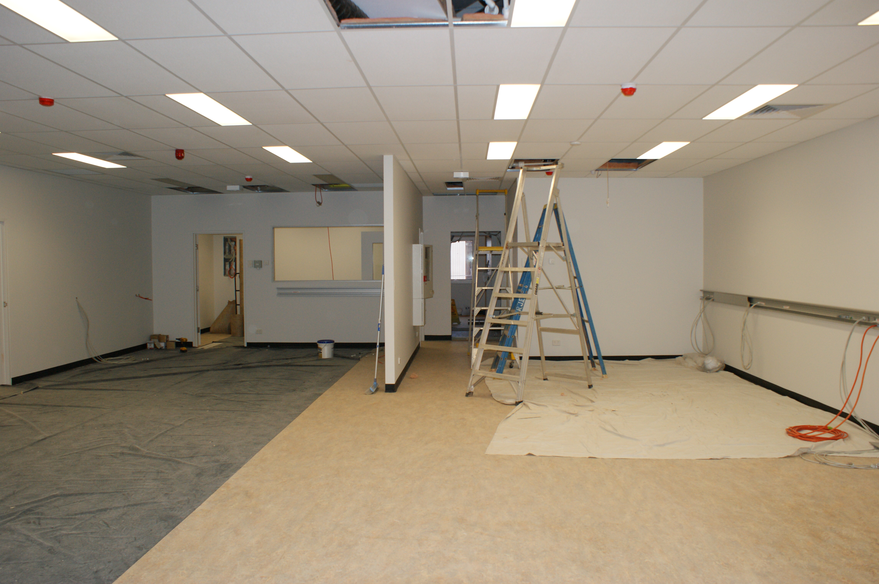
ASKAP – Control Room

Slide 64
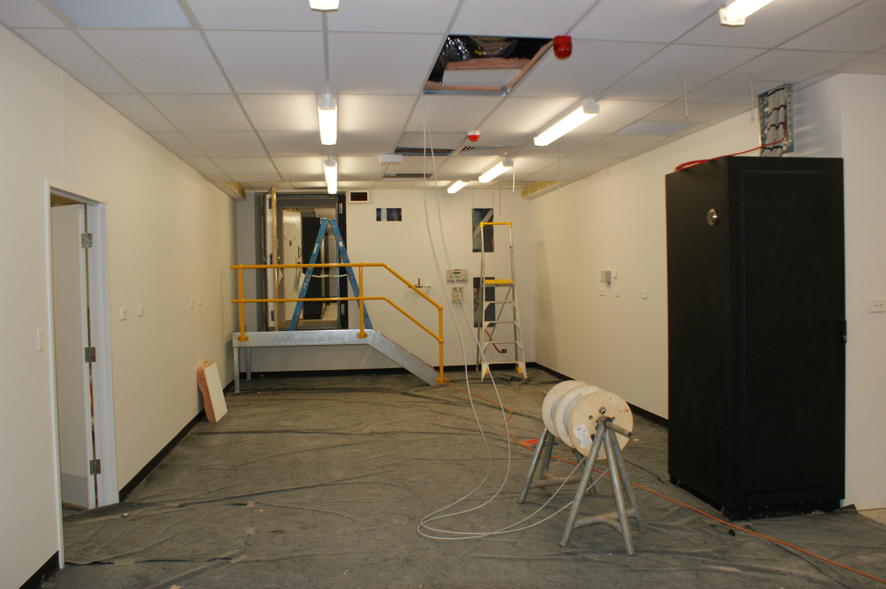
ASKAP – module installation

Slide 65
ASKAP Overview
ASKAP Science Goals
ASKAP Scope
ASKAP Location – the Murchison Radio-astronomy Observatory
Progress
  Antennas
  Phased Array Feeds (PAFs)
  Digital Systems
  Network connection to Pawsey HPC Centre for SKA Science
  Computing
  MRO Infrastructure and Power
  MRO Support Facility (Geraldton)
ASKAP Design Enhancements – Mark II
Current Status

Slide 66
MRO - Power Generation
3 November 2011 Minister Day and Minister Grylls announced approval of
$15.5 million grant to Horizon Power
For the design and construction of an RFI compliant hybrid diesel and solar
power plant for ASKAP and other facilities (e.g. MWA) at the MRO
Design well underway
  around 1 MegaWatt peak power
  500 kW of solar panels (PV) – increased to 1 MW in 2014 ?
Construction Completion expected end Q2 2013
(Operating from rental diesel gensets only 2012- early 2013)

Slide 67

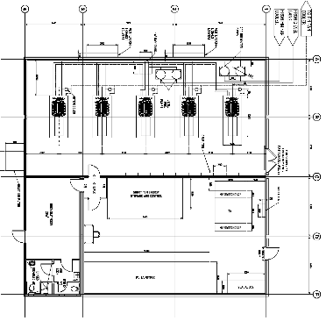
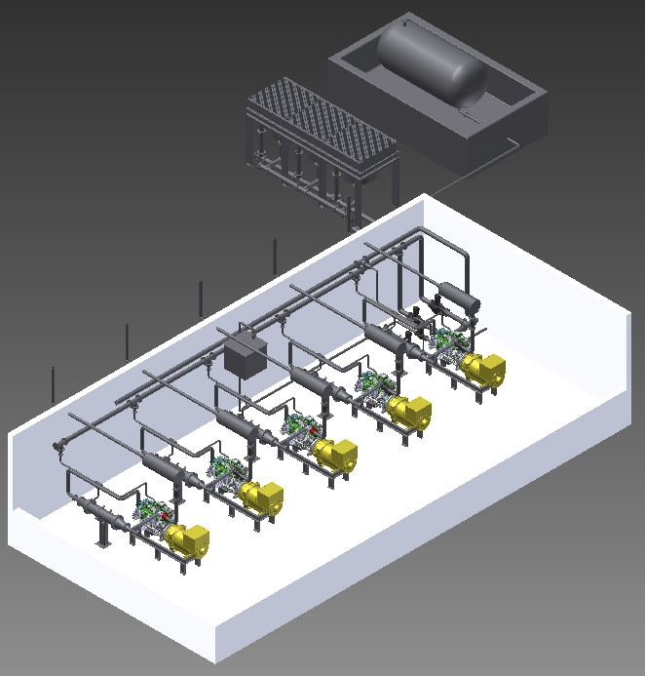
MRO Power Station Building Design
Modular design using the same construction technique as the ASKAP correlator building
Identical RFI mitigation techniques
Two levels of attenuation in the room design
Power station located > 1km from antennae
All RFI emissions reduced to > 20dB below MIL spec 461F
Notes:
67
Stage 1
500 kW PV and Short term energy storage:
STES will support network during loss of a engine
Support network during a fluctuation in solar energy generation
Park spinning reserve yielding a 24hr/dy fuel saving
Stage 2
Addition of 1 MW of PV and a long term Energy Storage Unit:
Storage of solar energy for consumption at night time
Support entire network in the event of a generation fault

Slide 68
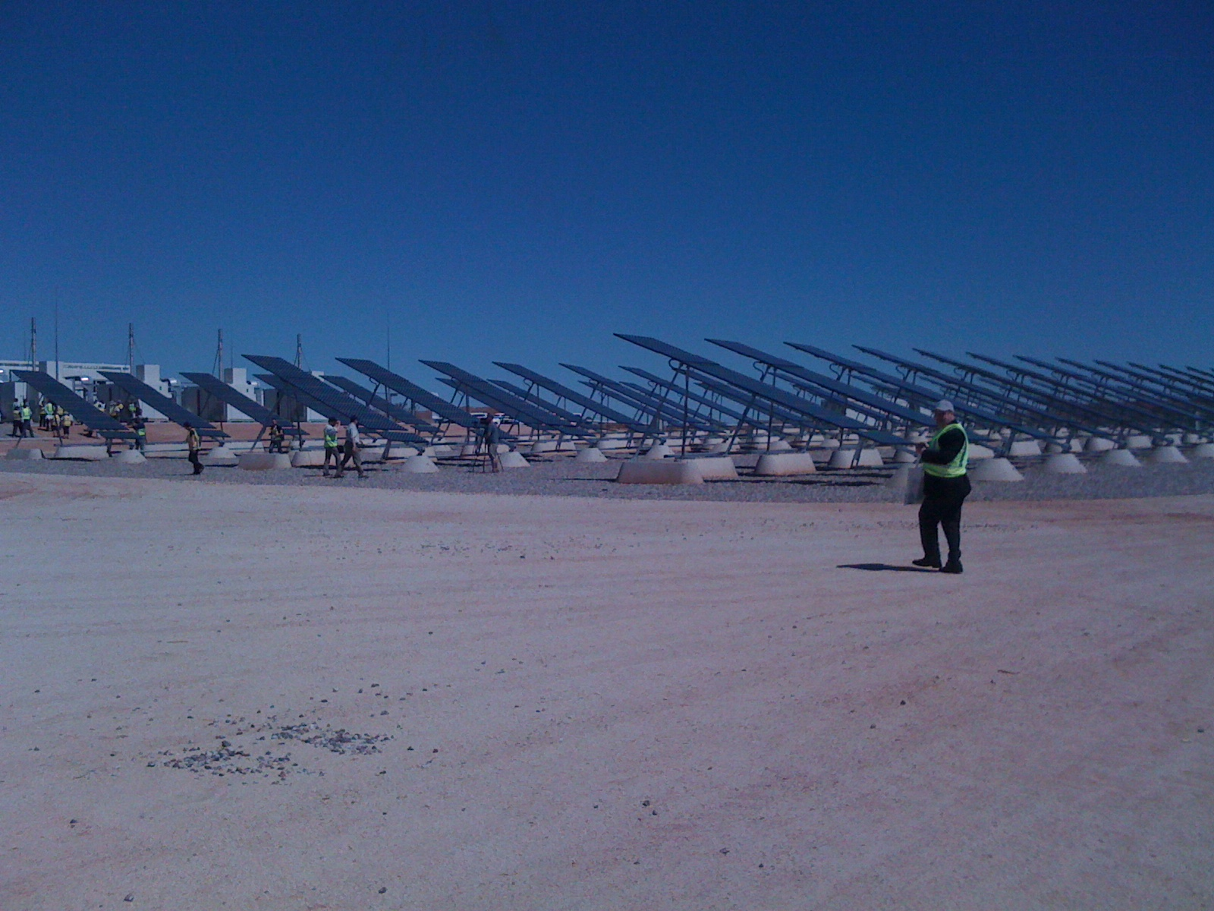
Horizon Power – Marble Bar hybrid station

Slide 69
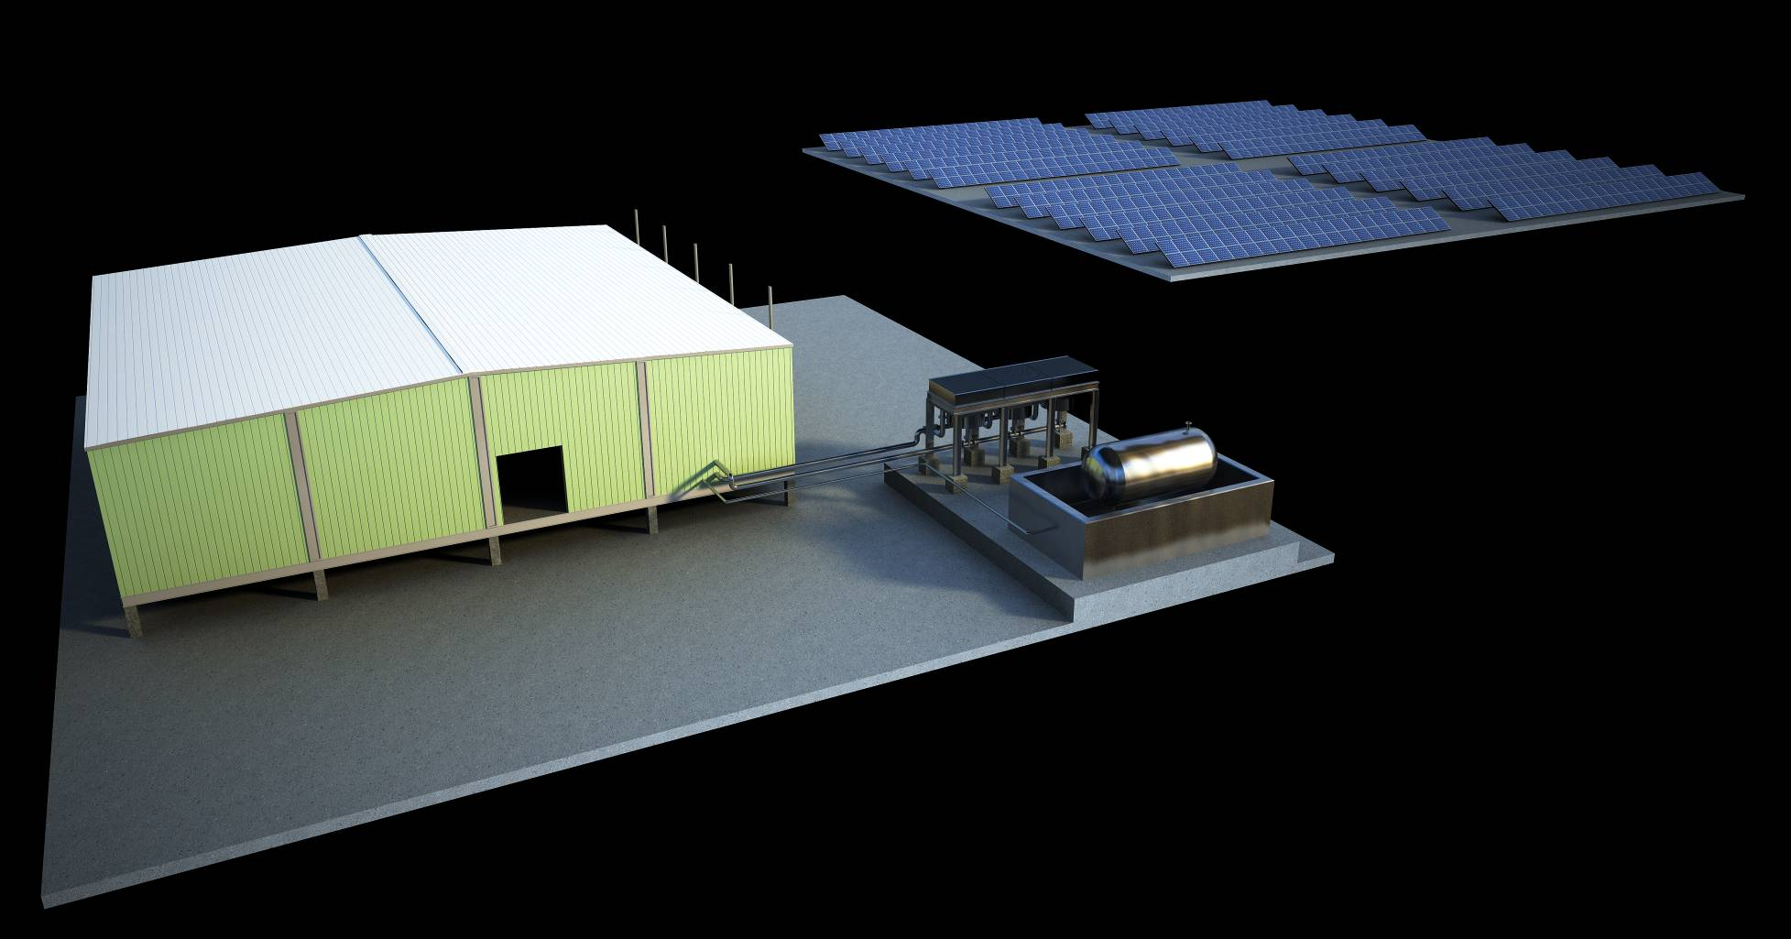
MRO Power Station Site Layout
Notes:
69
Stage 1
500 kW PV and Short term energy storage:
STES will support network during loss of a engine
Support network during a fluctuation in solar energy generation
Park spinning reserve yielding a 24hr/dy fuel saving
Stage 2
Addition of 1 MW of PV and a long term Energy Storage Unit:
Storage of solar energy for consumption at night time
Support entire network in the event of a generation fault

Slide 70
ASKAP Overview
ASKAP Science Goals
ASKAP Scope
ASKAP Location – the Murchison Radio-astronomy Observatory
Progress
  Antennas
  Phased Array Feeds (PAFs)
  Digital Systems
  Network connection to Pawsey HPC Centre for SKA Science
  Computing
  MRO Infrastructure and Power
  MRO Support Facility (Geraldton)
ASKAP Design Enhancements – Mark II
Current Status

Slide 71
ASKAP – MSF at the Geraldton University Centre
Notice to the industry of of intent to release a tender given in region
on 15 June 2011
RFT (Request for Tender) for the construction of the 800 sq m facility
was posted on Austender on 27 June
Closed on 5 August 2011
Contract award October 2011 to EMCO Pty Ltd (Perth)
Work commenced 9 January 2011
Occupancy expected December 2012

Slide 72
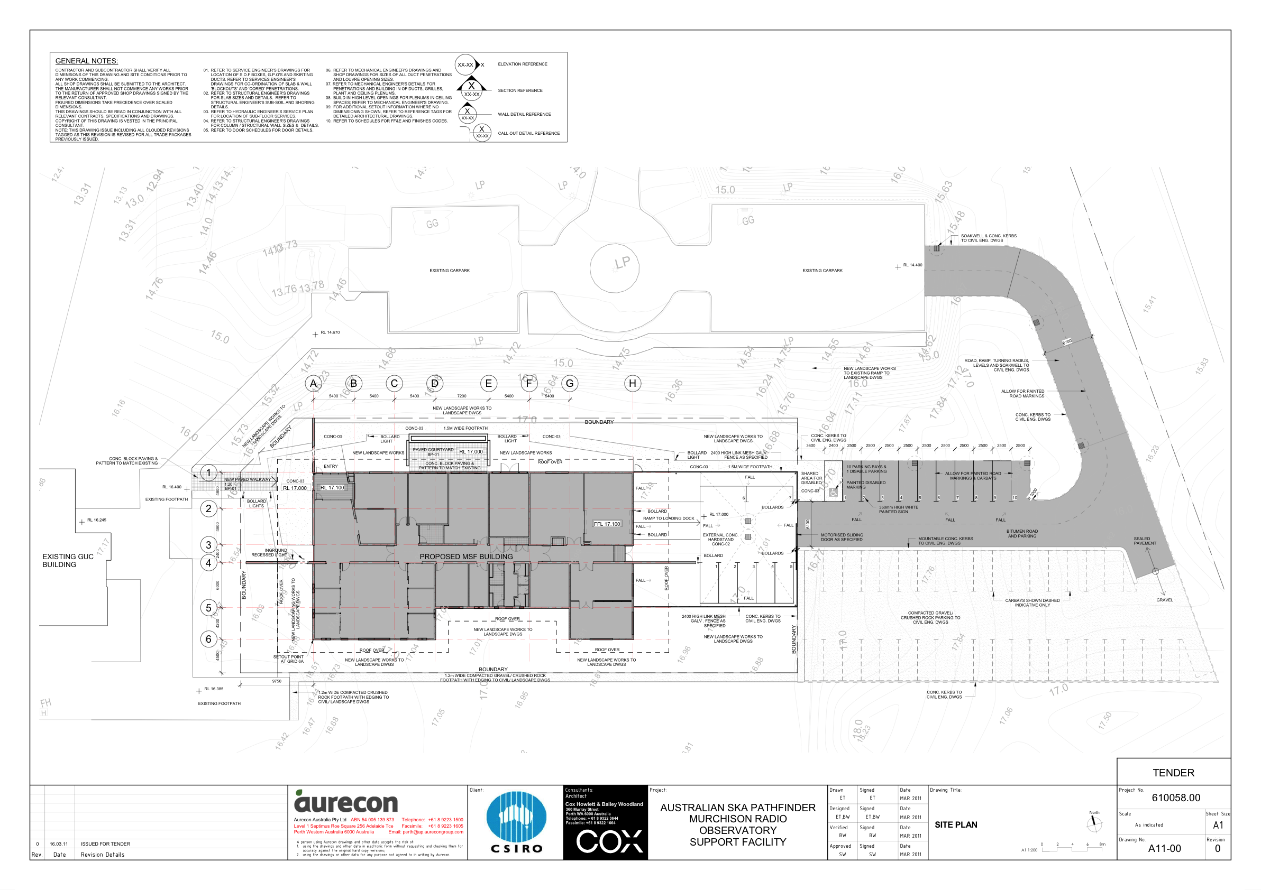
ASKAP – MSF at the GUC

Slide 73

ASKAP – MSF at the GUC

Slide 74

ASKAP – MSF at the GUC

Slide 75
ASKAP Overview
ASKAP Science Goals
ASKAP Scope
ASKAP Location – the Murchison Radio-astronomy Observatory
Progress
  Antennas
  Phased Array Feeds (PAFs)
  Digital Systems
  Network connection to Pawsey HPC Centre for SKA Science
  Computing
  MRO Infrastructure and Power
  MRO Support Facility (Geraldton)
ASKAP Design Enhancements – Mark II
Current Status

Slide 76
ASKAP Design Enhancement
ASKAP:
- rapid research and development cycles in all areas:
- PAFs – chequerboards, LNAs etc
- Data Transport – “ribbon” fibres, analog over fibre
- Digital Systems
- Computing
- New technologies coming on line quickly
- laser modulation allowing RFoF economically (factor of 45
drop in price in 24 months !)
- V7 of Xilinx FPGA family
- Analog to Digital Convertors

Slide 77
ASKAP
ASKAP Design Enhancements (ADE)
  Apply “Lessons learnt” from current PAF knowledge, BETA etc. Areas include:
  - mechanical packaging, size, impacts of RFoF, cooling etc
  2. Incorporate new technologies
  - RF over Fibre
  - recent rapid price drop of optical components
  - minimise cable loses, stability,
  - continuous fibre from PAF to beamformer in central building
  - removes 95% of equipment from pedestal – cooling, RFI, elec
  - Virtex 7 – newest Xilinx FPGA family – factor of 4++ reductio
  - Direct sampling – deletes entire heterodyning sub-system
  - Mk II systems will be compatible with Mk I (12 PAF observing)
  Build and install 6 of these new Mk II designed systems on ASKAP
  Antennas by March 2013

Slide 78
ASKAP
Components to the plan:
Complete BETA, including:
  6 antennas with Mk I (existing) PAFs and Digital systems
  36 antennas + infrastructure (pads, power and fibre)
  MRO infrastructure, fibre link to Geraldton, building, MSF, Power station
  Commissioning – and learning how to do astronomy with PAFs and beamformers
ASKAP Design Enhancements (ADE)
  Apply learning from ASKAP, including;
  - RFoF (“RF over fibre”)
  - PAF – RFoF-ready, high frequency improvement, re-packaging
  - Digital systems (Virtex 7, leaner, faster, cheaper)
  - Equip additional 6 antennas with new Mk II PAFs (March2013)

Slide 79
ASKAP
Components to the plan:
Complete BETA, including:
  6 antennas with Mk I (existing) PAFs and Digital systems
  36 antennas + infrastructure (pads, power and fibre)
  MRO infrastructure, fibre link to Geraldton, building, MSF, Power station
  Commissioning – and learning how to do astronomy with PAFs and beamformers
ASKAP Design Enhancements (ADE)
  Apply learning from ASKAP, including;
  - RFoF (“RF over fibre”)
  - PAF – RFoF-ready, high frequency improvement, re-packaging
  - Digital systems (Virtex 7, leaner, faster, cheaper)
  - Equip additional 6 antennas with new Mk II PAFs (March2013)

Slide 80
ASKAP Overview
ASKAP Science Goals
ASKAP Scope
ASKAP Location – the Murchison Radio-astronomy Observatory
Progress
  Antennas
  Phased Array Feeds (PAFs)
  Digital Systems
  Network connection to Pawsey HPC Centre for SKA Science
  Computing
  MRO Infrastructure and Power
  MRO Support Facility (Geraldton)
ASKAP Design Enhancements – Mark II
Current Status

Slide 81
ASKAP Key Milestone Overview
PAF on Parkes Testbed 12m August 2011
PAF on MRO antenna October 2011
Three Mk I PAF’s on BETA March 2012
(digital systems included)
Six Mk I PAF’s (BETA) May 2012
Limited BETA observing – start
- phase closure April 2012
- commissioning focus
- aim is to generate basic data files
- primary BETA capability early 2012
- preliminary BETA data measurement sets Q3 2012
MRO Infrastructure complete – February 2012
Six Mark II PAFs and Digital subsystems – March 2013 (total 12 PAFs)

Slide 82

We acknowledge the Wajarri Yamatji people as the traditional owners of the Observatory site.

Slide 83



Thank you
More information: www.atnf.csiro.au/projects/askap
Antony Schinckel
Phone: 02 9372 4101
Email: antony.schinckel@csiro.au

